Slide 1
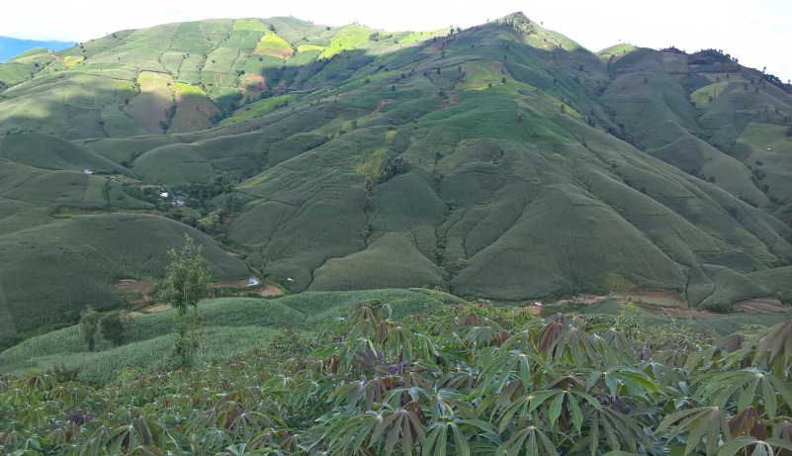





AGRONOMY ACTIVITIES
IN SON LA
Lê Việt Dũng
Phan Huy Chương
Cù Thị Lệ Thủy
Phạm Thị Sến
Malik Imran
Jonathan Newby

Slide 2
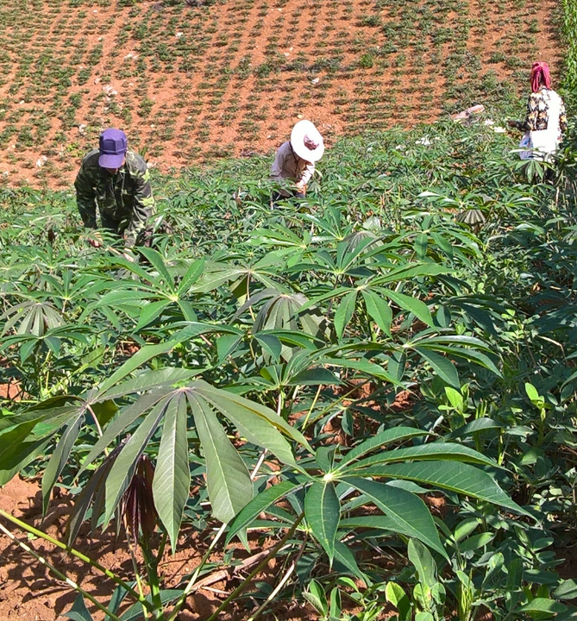
Outlines
Introduction and objectives
Activities implemented
  Selection of sites
  Designing of trials
  Establishment of trials
Trial results
  Variety trial
  Fertilizer trial
  Soil management trial
  Density trial
  Harvesting time trial
Demonstrations for scaling out

Slide 3
Introduction and objectives
SơnLa has the largest cassava production area in the northern mountainous region of Vietnam (NMR)
Cassava became an important cash crop in SơnLa. It’s has significant value for living and economic development of poor farming households

Slide 4
Introduction and objectives
Variety trial
Mono cropping
Problems:
1. Land erosion & degradation
2. Low & unstable yield & income
Sloping land
Fertilizer trial
Few old varieties
Soil management trial
Objectives:
Land erosion control
Land nutrient improvement
Income improvement
Traditional practice SnB
Density trial
Non-optimal fertilizer rate
Harvesting time trial

Slide 5
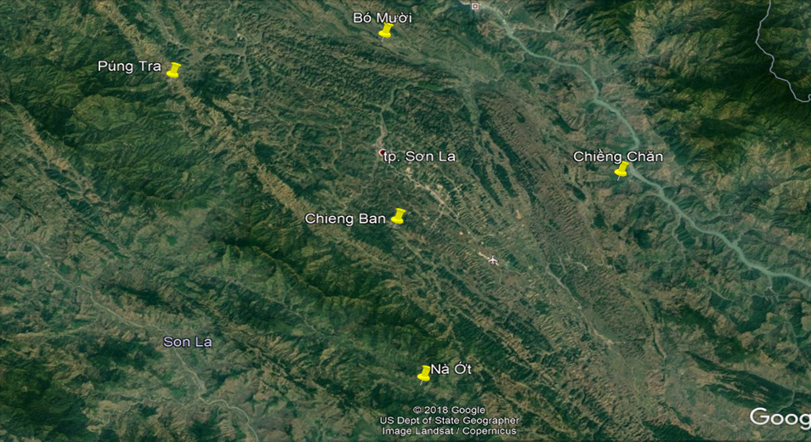
Summary of activities in 2018
Feb.-
April
Selection of the fields
Establishment of the trials
May-
Nov.
Managing the trials
Dec.-
Feb
Organizing harvest field days
Harvesting the trials
Recording the parameters
Writing the report, proposing for 2019

Slide 6
Trial sites
 | Chiềng Chăn commune, Mai Son dist. | Nà Ớt commune, Mai Son dist. | Bó Mười commune, Thuan Chau dist. | Púng Tra commune, Thuan Chau dist.
Area (km²) | 60.03 | 106.50 | 62.21 | 25.64
Population | 6,449 | 2,976 | 8,163 | 3,138
Ethnicity | Thái, H’Mông, Kinh | Thái, Khơ Mú, Sinh Mun, H’Mông | 100% Thái | 97,2% Thái 2,8% La Ha
No. of villages | 19 | 17 | 18 | 14
Cassava area (ha) | 244 | 541 | 100 | 750
Main crops | maize, cassava, sugarcane | cassava, coffee | maize, cassava | cassava, coffee
In each of these communes, over 70% households grow cassava with an average land size of 0.3 – 0.9 ha each, mostly on steep slopes (up to 65º), and soil erosion is perceived as a serious problem

Slide 7
 | Trial | Location | Area (ha) | Slope (degree) | Design | Ethnicity Farmer
1 | Variety | Sài Lương village, Chiềng Chăn | 0.15 | 20-25 | Big Plots | Thai
2 | Variety | Púng Mé Village, Púng Tra | 0.15 | 45-50 | Big Plots | Thái
3 | Fertilizer | Há Xét village,Nà Ớt | 0.15 | 55-60 | Big Plots | Thái
4 | Fertilizer | Long Sàn Village, Bó Mười | 0.1 | 5-10 | Big Plots | Thái
5 | Fertilizer | Púng Mé Village, Púng Tra | 0.15 | 10-15 | Big Plots | Thái
6 | Soil management | Sài Lương village, Chiềng Chăn | 0.25 | 35-40 | CRB, 4 replicates | Thái
7 | Soil management | Há Xét village, Nà Ớt | 0.2 | 55-60 | CRB, 3 replicates | Sinh Mun
8 | Soil management | Long Sàn Village, Bó Mười | 0.15 | 40-45 | CRB, 3 replicates | Thái
9 | Soil management | Púng Mé Village, Púng Tra | 0.25 | 45-50 | CRB, 5 replicates | Thái
10 | Density | Púng Mé Village, Púng Tra | 0,1 | 45-50 | Big Plots | Thái
11 | Density | Sài Lương Village, Chieng Chăn | 0,1 | 15-20 | Big Plots | Thái
12 | Havest time | NW station belong NOMAFSI (Chieng Ban – Mai Sơn) | 0,3 | 10-15 | Big Plots

Slide 8
Variety trial
(2 sites 1 in total, 1 site in each district)
V1: 13Sa05
V2: Sa21-12
V3: Rayong 9
V4: BK
V5: KM 94 (Control, a locally popular HYV)
V6: La Tre (Control 1, a local variety)
Fertilizer: separate N, P, and K fertilizers (60N+15P+ 60K), Basal fertilizing: All of P, 1/3 N
1st Top dressing: 1/3 N, 1/3 K (45 days after sowing); 2 ^{nd} top dressing: 1/3N, 2/3 K (75 days after planting
Density: 1mx1m, 10.000 plants ha⁻¹

Slide 9
Fertilizer trial:
(4 sites in total, 2 sites in each district)
CT1: No fertilizer
CT2 :NPK (5-10-3) 300 kg ha-1 basal application,
CT3: NPK (12:5:10) 300 kg ha-1 basal application,
CT4: 40N-10P-40K (i.e. 87 kg Urea, 142 kg Superphosphate, 80 kg KCl),
CT5: 60N-15P-60K (i.e. 130 kg Urea, 213 kg Superphosphate, 120 kg KCl,
Note: CT2 and CT3 was applied at planting and for CT4 and CT5 all Phosphorous was applied at planting with 1/3rd of N, rest of N and K was top dressed in two application 45 and 75 days after planting
Variety: KM94
Density: 1mx1m, 10.000 plants ha⁻¹

Slide 10
Soil management trial:
(4 sites in total, 2 sites in each district)
CT1 (control): Cassava mono cropping
CT2: Cassava + cowpea
CT3: Cassava + mung bean
CT4: Cassava + peanut
CT5: Cassava + grass trip (Ghinea, Panicum maximum)
CT6: Cassava+ contour barriers by residues of cassava plants of the last crop
Variety: KM 94
Density: 1mx1m, 10.000 plants ha⁻¹
Fertilizer: separate N, P, and K fertilizers (60N+15P+ 60K), Basal fertilizing: All of P, 1/3 N
1st Top dressing: 1/3 N, 1/3 K (45 days after sowing); 2nd top dressing: 1/3N, 2/3 K (75 days after planting

Slide 11
Density trial
(2 sites 1 in total, 1 site in each district)
M1: 0.8m X 0.6m, (20,800 plant ha⁻¹),
M2 : 0.8m X 0.8m, (15,600 plant ha⁻¹)
M3 : 0.8m X 1.0m, (12,500 plant ha⁻¹)
M4 : 1.0m X 1.0m (10,000 plant ha⁻¹)
Variety: KM 94
Density: 1mx1m, 10.000 plants ha⁻¹
Fertilizer: separate N, P, and K fertilizers (60N+15P+ 60K), Basal fertilizing: All of P, 1/3 N
1st Top dressing: 1/3 N, 1/3 K (45 days after sowing); 2nd top dressing: 1/3N, 2/3 K (75 days after planting

Slide 12
HARVESTING TIME TRIAL
CT1: December (2018) | CT6: Jun (2019)
CT2: January (2019) | CT7: July (2019)
CT3: March (2019) | CT8: August (2019)
CT4: April(2019) | CT9: September (2019
CT5: May(2019) | CT10: November (2019)
Variety: KM 94, Lá Tre
Density: 1mx1m, 10.000 plants ha⁻¹
Fertilizer: separate N, P, and K fertilizers (60N+15P+ 60K), Basal fertilizing: All of P, 1/3 N
1st Top dressing: 1/3 N, 1/3 K (45 days after sowing); 2nd top dressing: 1/3N, 2/3 K (75 days after planting

Slide 13
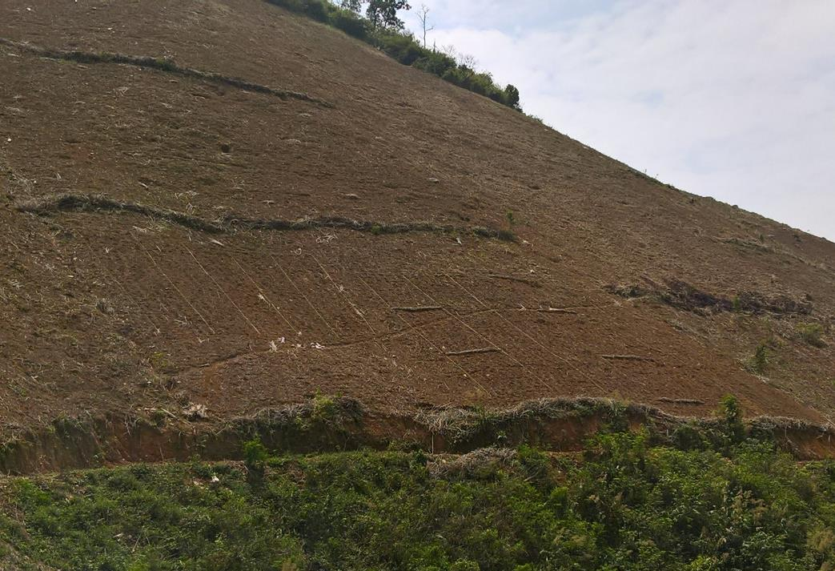
Fertilizer and land management trials blocks in Na Ot
Fertilizer trial
Soil management trial

Slide 14
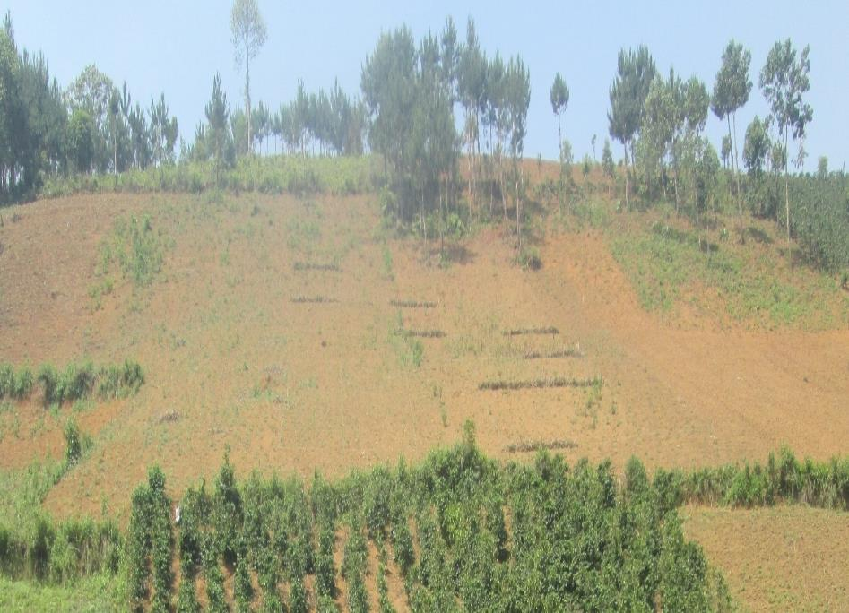
Soil management trial in Púng Tra

Slide 15
Participants in the trials
Northern Mountainous Agriculture and Forestry Science Institute (NOMAFSI): responsible for all the trials.
Farmers, the land owners: participated in all the activities (trials establishment, management and harvest).
DARD of Son La, and DARD of both Thuan Chau and Mai Son districts: local focal point
People committees of Chieng Chan, Na Ot, Pung Tra and Bo Muoi: commune focal point
Son La Cassava Factory (FOCOCEV): advices on the trial planning, starch content measurement
CIAT and UQ researchers: Advice on the trials treatments and design, and in other related technical issues

Slide 16
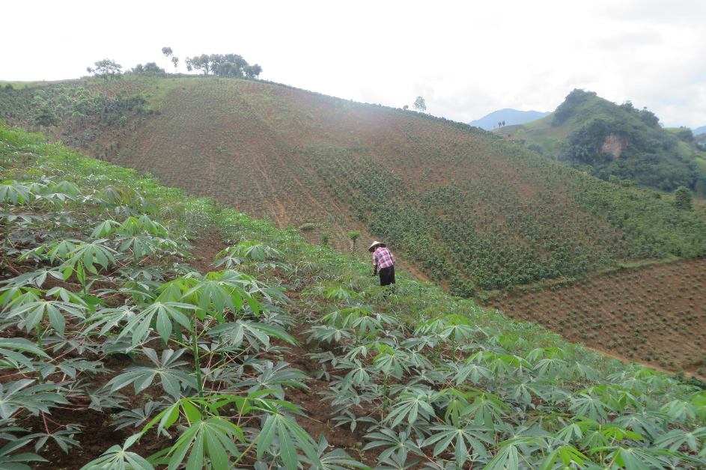
RESULT OF VARIETY TRIAL

Slide 17
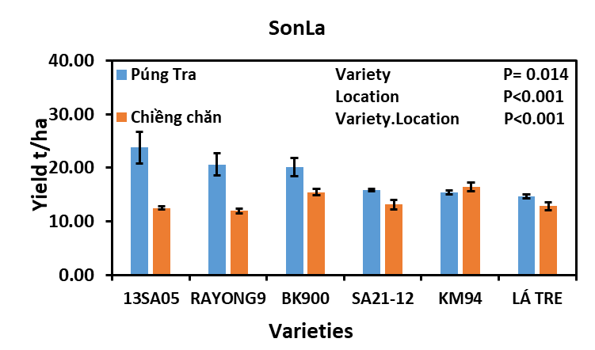
Figure1: Yield of cassava fresh root, variety trial

Slide 18
Starch content (%)
Varieties | Púng Tra (28/11/2018) | Chiềng Chăn (23/1/2019)
KM94 | 30 | 28,2
13SA05 | 30 | 29,8
RAYON9 | 27,7 | 28
LÁ TRE | 30 | 30
BK | 28,7 | 30
SA21-12 | 30 | 29,7

Slide 19
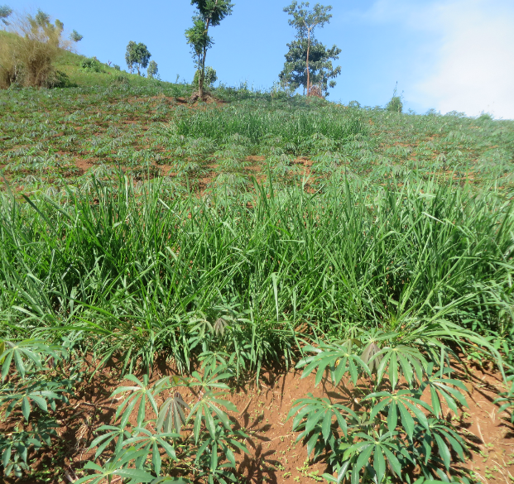
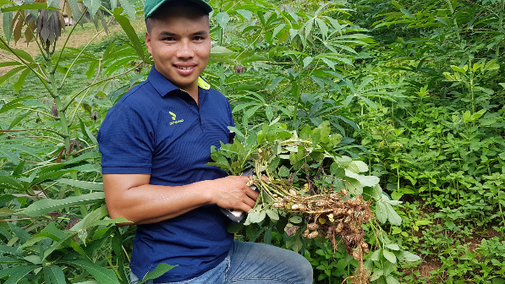
RESULT OF SOIL MANAGEMENT TRIAL

Slide 20
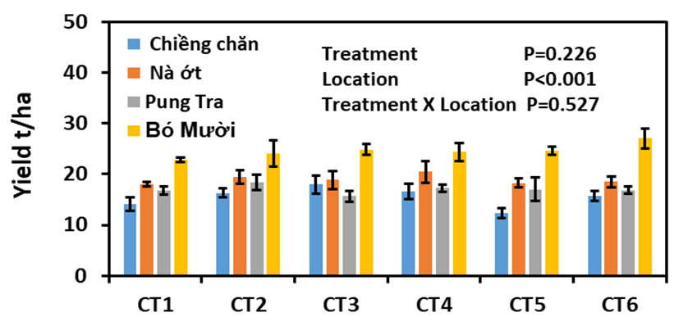
Figure2: Yield of cassava fresh roots, soil management trial, 2018
CT1 (control): Cassava mono cropping, CT2: Cowpea intercropped, CT3: Mung bean intercropped, CT4: Peanut intercropped, CT5: Grass trip and CT6: residues of cassava from previous crop on contour lines

Slide 21
Table 1: Yield of legume and biomass of intercropping
Local | COWPEA |  | MUNGBEAN |  | PEANUT |  | GRASS TRIP
 | Yield (kg/ha) | Biomass (tons/ha) | Yield (tons/ha) | Biomass (tons/ha) | Yield (kg/ha) | Biomass (tons/ha) | Biomass (tons/ha)
Chiềng Chăn | 128,75 | 1,11 | 0,00 | 0,00 | 220,83 | 1,47 | 5,02
Nà Nớt | 372,00 | 1,63 | 94,00 | 1,63 | 613,33 | 1,63 | 7,50
Púng Tra | 124,8 | 1,02 | 0,00 | 0,17 | 256,00 | 0,91 | 4,29
Bó Mười | 661,11 | 2,00 | 233,3 | 4,52 | 1327,78 | 2,04 | 4,53

Slide 22
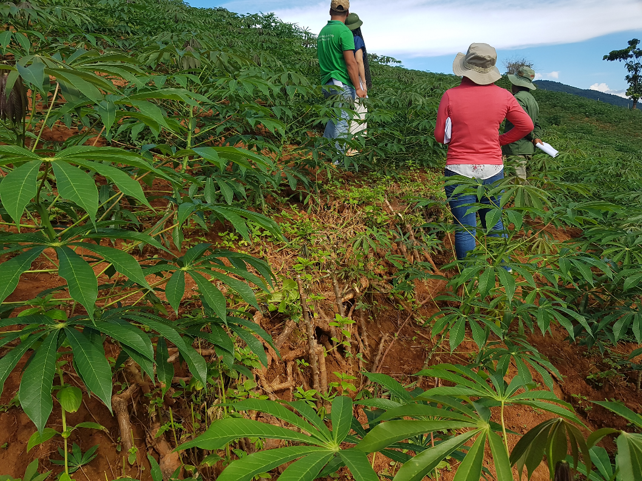
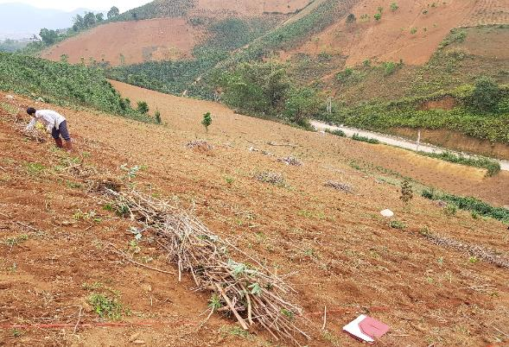
Contour line keep soil loss from soil erosion

Slide 23
Table 2: in come and input of soil management trial in Púng Tra, 2018
 | CT1 | CT2 | CT3 | CT4 | CT5 | CT6
Gross return | 23.496 | 28.932 | 23.070 | 29.946 | 24.978 | 24.630
Total material cost (000vnd) | 4.028 | 5.210 | 5.260 | 5.560 | 4.092 | 3.924
Total labour | 179 | 215 | 202 | 220 | 197 | 183
Net return | 19.468 | 23.722 | 17.810 | 24.386 | 20.886 | 20.706
Net return per working day (000vnd) | 108,76 | 110,33 | 88,17 | 110,85 | 106,02 | 113,15
Net return per 1vnd spent | 4,83 | 4,55 | 3,39 | 4,39 | 5,10 | 5,28
CT1 (control): Cassava mono cropping, CT2: Cowpea intercropped, CT3: Mung bean intercropped, CT4: Peanut intercropped, CT5: Grass trip and CT6: residues of cassava from previous crop on contour lines

Slide 24
Table 3: in come and input of soil management trial in Bó Mười, 2018
 | CT1 | CT2 | CT3 | CT4 | CT5 | CT6
Gross return | 33.650 | 59.930 | 44.615 | 55.111 | 37.525 | 42.937
Total material cost (000vnd) | 4.028 | 5.210 | 5.260 | 5.560 | 4.092 | 3.924
Total labour | 187 | 232 | 224 | 230 | 209 | 205
Net return | 29.622 | 54.720 | 39.355 | 49.551 | 33.433 | 39.013
Net return per working day (000vnd) | 158,41 | 235,86 | 175,69 | 215,44 | 159,97 | 190,31
Net return per 1vnd spent | 7,35 | 10,50 | 7,48 | 8,91 | 8,17 | 9,94
CT1 (control): Cassava mono cropping, CT2: Cowpea intercropped, CT3: Mung bean intercropped, CT4: Peanut intercropped, CT5: Grass trip and CT6: residues of cassava from previous crop on contour lines

Slide 25
Table 4: in come and input of soil management trial in Nà Ớt, 2018
 | CT1 | CT2 | CT3 | CT4 | CT5 | CT6
Gross return | 27750 | 37869 | 36855 | 37857 | 32235 | 32235
Total material cost (000vnd) | 3.411 | 4.628 | 4.678 | 4.978 | 3.510 | 3.342
Total labour | 176 | 216 | 219 | 221 | 199 | 186
Net return | 24.339 | 33.241 | 32.177 | 32.879 | 28.725 | 28.893
Net return per workingday (000vnd) | 138.29 | 153.89 | 146.93 | 148.77 | 144.35 | 155.34
Net return per 1vnd spent | 7.13 | 7.18 | 6.88 | 6.61 | 8.18 | 8.65
CT1 (control): Cassava mono cropping, CT2: Cowpea intercropped, CT3: Mung bean intercropped, CT4: Peanut intercropped, CT5: Grass trip and CT6: residues of cassava from previous crop on contour lines

Slide 26
Table 5: in come and input of soil management trial in Chiềng Chăn, 2018
 | CT1 | CT2 | CT3 | CT4 | CT5 | CT6
Gross return | 21.143 | 34.008 | 29.727 | 30.043.25 | 18.425 | 23.456
Total material cost (000vnd) | 3.411 | 4.628 | 4.678 | 4.978 | 3.510 | 3.342
Total labour | 164 | 203 | 202 | 205 | 174 | 171
Net return | 17.732 | 29.381 | 25.050 | 25.065 | 14.915 | 20.114
Net return per workingday (000vnd) | 108,12 | 144,73 | 124,01 | 122,27 | 85,72 | 117,63
Net return per 1vnd spent | 5,20 | 6,35 | 5,36 | 5,04 | 4,25 | 6,02
CT1 (control): Cassava mono cropping, CT2: Cowpea intercropped, CT3: Mung bean intercropped, CT4: Peanut intercropped, CT5: Grass trip and CT6: residues of cassava from previous crop on contour lines

Slide 27
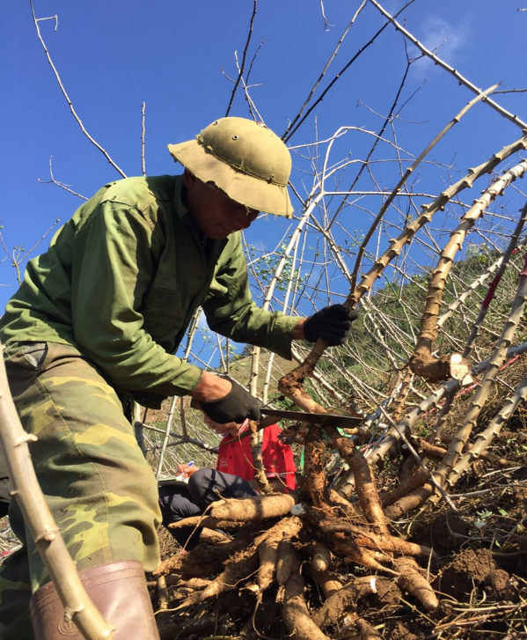
RESULT OF FERTILIZER TRIAL

Slide 28
Figure 3: Yield of Fresh tuber, fertilizer trial, 2018

Slide 30
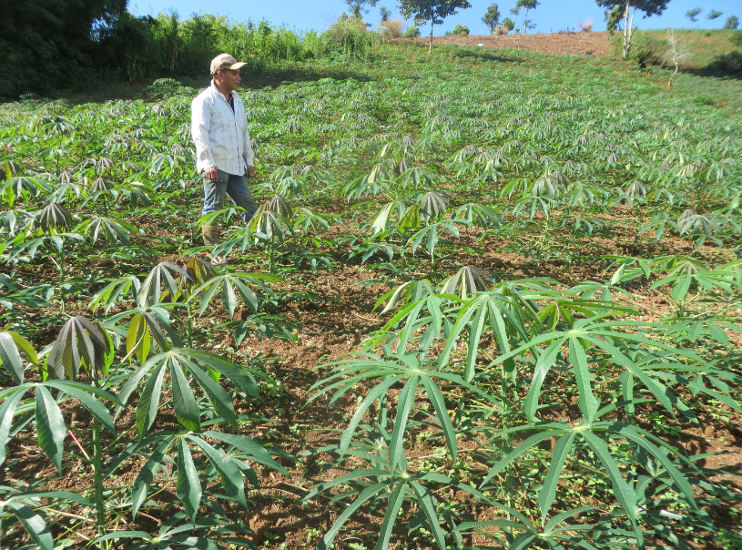
RESULT OF DENSITY TRIAL

Slide 31
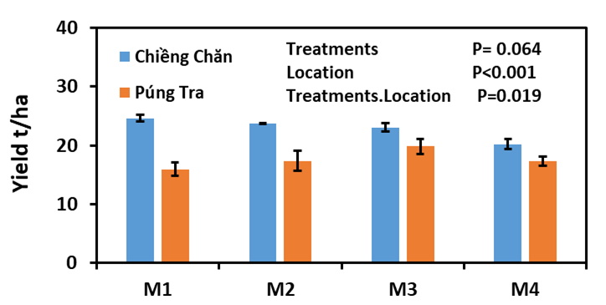
Figure 5: Yield of fresh root, density trial 2018

Slide 32
Table 6 : in come and input of density trial in Púng Tra
 | M1 | M2 | M3 | M4
Gross return | 23.920 | 26.050 | 29.750 | 25.990
Total material cost (000vnd) | 5.108 | 4.588 | 4.278 | 4.028
Total labour | 191 | 187 | 191 | 183
Net return | 18.812 | 21.462 | 25.472 | 21.962
Net return per workingday (000vnd) | 98.49 | 114.77 | 133.36 | 120.01
Net return per 1vnd spent | 3.68 | 4.68 | 5.95 | 5.45

Slide 33
Table 7: Income and input of density trial in Chiềng Chăn
 | M1 | M2 | M3 | M4
Gross return | 36.953 | 35.625 | 34.609 | 30.312
Total material cost (000vnd) | 5,108 | 4,588 | 4,278 | 4,028
Total labour | 216 | 205 | 200 | 190
Net return | 31,845 | 31,037 | 30,331 | 26,284
Net return per workingday (000vnd) | 147.43 | 151.40 | 151.66 | 138.34
Net return per 1vnd spent | 6.23 | 6.76 | 7.09 | 6.53

Slide 34
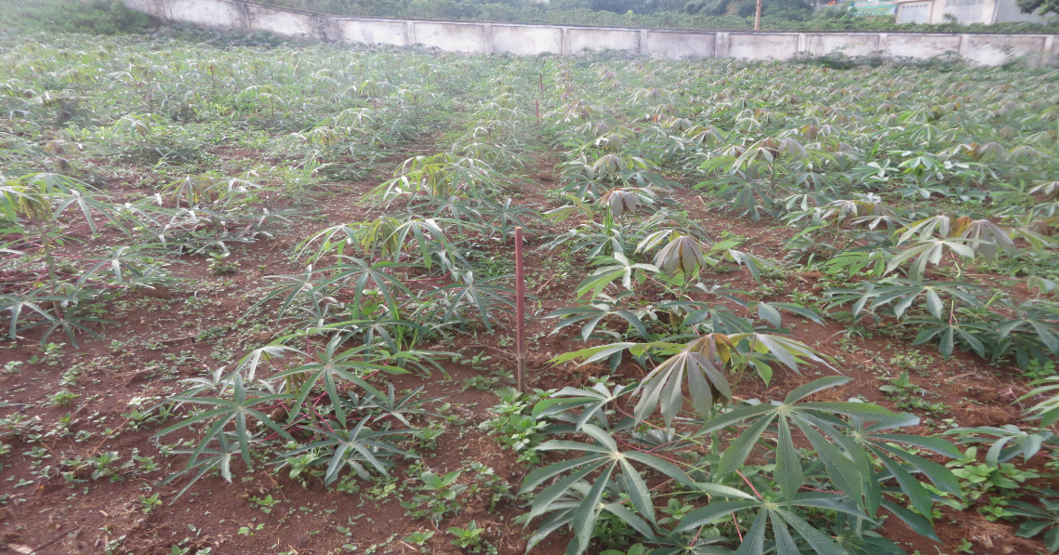
RESULT OF HARVESTING TIME TRIAL

Slide 35
Figure 6 : Yield and starch content of harvesting time trial

Slide 36
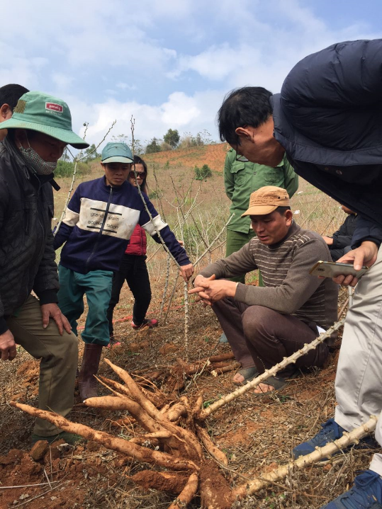
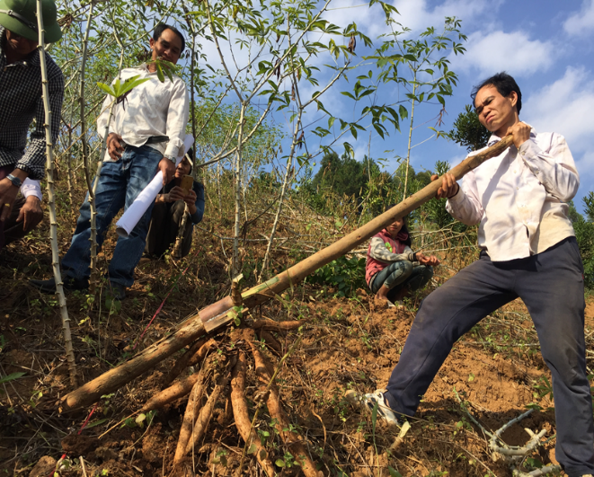
FIELD DAY

Slide 37
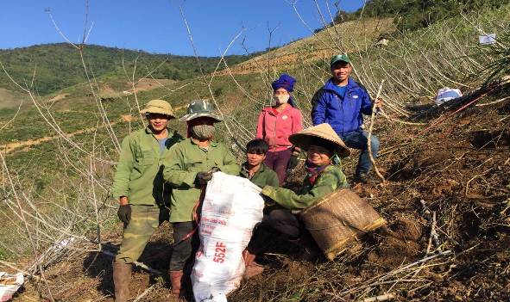
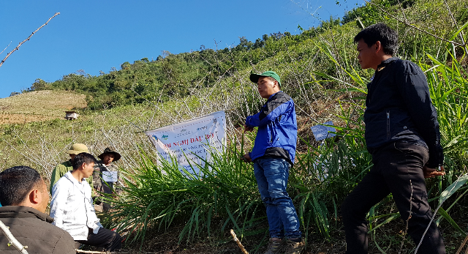
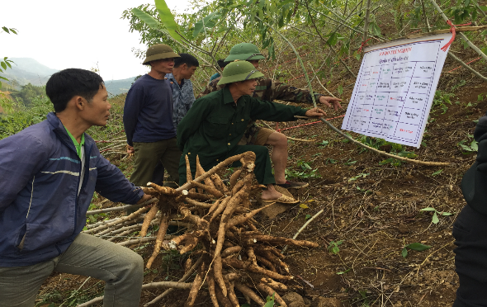
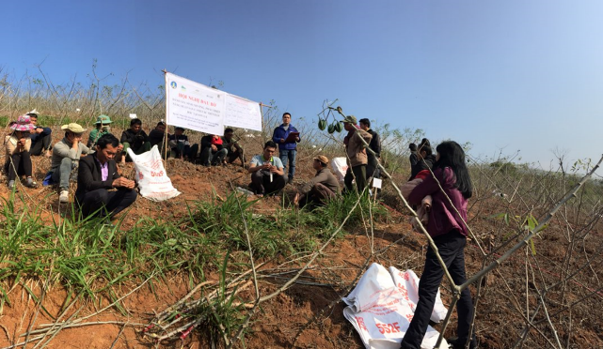

Slide 38
DEMOSTRATION TOWARDS SCALING-OUT
- Each farmer select practice to pilot in their field
- Planning action plan for each farmer
Manage the cassava plots (CA + ICM)
Field days for demonstration and participatory evaluation of practices
- Train the farmers
- Establish practice plots of each farmer
Volunteer farmers
List volunteer farmers in 2018
 | Farmer name | Location | Area (m²) | Practice selection
1 | Vì Văn Thiện | Bản Há Xét, xã Nà Ớt, huyện Mai Sơn | 1000 | cassava + peanut
2 | Tòng Văn Vĩnh | Bản Há Xét, xã Nà Ớt, huyện Mai Sơn | 500 | Cassava + cowpea
3 | Lường Văn Dũng | Púng Mé- Púng Tra - Thuận Châu | 1000 | Cassava + grass trip
Total |  |  | 2.500

Slide 39
List volunteer farmers in 2019
1 | Farmer name | (Location) | Area ( m²) | Practice selection
1 | Lò Văn Thịnh | Noong ỏ - Púng Tra | 1,000 | cassava BK + grass trip + cowpea
2 | Lường Văn Chinh | Púng Lọng - Púng Tra | 1,000 | cassava Bk and cassava13sa05
3 | Lò Văn Sĩ | Púng Tan - Púng Tra | 1,000 | cassava BK and 13sa05 + grass trip
4 | Lường Văn Dũng | Púng Mé - Púng Tra | 1,000 | cassava BK and 13sa05 + grass trip
5 | Lường Văn Chiến | Noong ỏ - Púng Tra | 1,000 | cassava BK and 13sa05 + grass trip
6 | Quàng Văn Kiên | Púng Mé - Púng Tra | 500 | cassava BK + grass trip
7 | Lường Văn Thẩm | Púng Mé - Púng Tra | 1,000 | cassava BK and 13sa05 + grass trip
8 | Lường Văn Sơn | Bản Tra - Púng Tra | 1,000 | cassava BK and 13sa05+ grass trip
9 | Lường Văn Chơ | Nà Mắt - Púng Tra | 1,000 | cassava
10 | Lường Văn Nguyên | Sài Lương - Chiềng Chăn | 1,500 | cassava BK and 13sa05 + contour line + cowpea + density 0.8 x 1m
11 | Lường Văn Trường | Sài Lương - Chiềng Chăn | 1,500 | cassava BK and 13sa05
12 | Lò Văn Nhỡ | Sài Lương - Chiềng Chăn | 1,000 | cassava BK and 13sa05
13 | Lường Văn Hinh | Sài Lương - Chiềng Chăn | 1,000 | cassava BK and 13sa05
14 | Vì Văn Thiện | Há Xét - Nà Ớt | 1,000 | cassava BK and 13sa05 + cowpea + density 0.8 x 1m
15 | Lò Văn Thương | Há Xét - Nà Ớt | 1,000 | cassava BK and 13sa05 + cowpea
16 | Lò Văn Hợp | Hin Đón - Nà Ớt | 1,000 | cassava BK and 13sa05+ peanut
17 | Lò Văn Diêu | Hin Đón - Nà Ớt | 1,000 | cassava BK and 13sa05+ cowpea
18 | Quàng Văn Quý | Huổi kẹt - Nà Ớt | 1,000 | cassava BK and 13sa05+ peanut
19 | Lò Văn Thương | Huổi kẹt - Nà Ớt | 1,000 | cassava BK and 13sa05+ peanut
20 | Giàng A Chua | Pá Khoang - Nà Ớt | 1,000 | cassava BK and 13sa05
Total |  |  | 20.500

Slide 40
CONCLUSIONS
Research results obtained so far allow us to include the following points for confirmation when the last harvest has been completed in March 2020:
Two new varieties 13Sa05 and BK are appropriate and should be promoted for large scale production in Son La
The use of separate N, P, K fertilizers bring better economic benefits compared to mixed NPK (5-10-3) fertilizers; the level of (40N, 10P, 40K) or (60N, 15P, 60K) applied at 3 times (1 basal and 2 topdressing times) bring the highest economic benefit.

Slide 41
CONCLUSIONS
The planting density of 12,500 plants/ha (distance of 1 m x 0.8 m) is most suitable for the local conditions (poor sloping lands and low investment capacity of farmers)
Intercropping with cowpea or peanut increase the yield and economic benefits as well as gross income, while cassava-plant- residue contour significantly prevent soil from being washed off away and proffered by farmers for adoption.
There are barriers to adoption of soil management practices: Increased labour requirement, increased inputs, farmer used to conventional practices and not ready to change

Slide 42
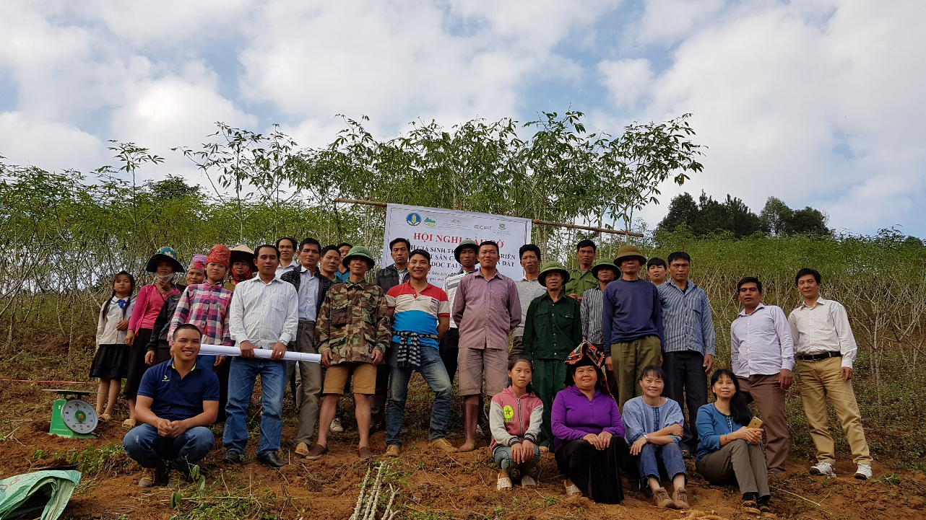
THANK YOU FOR YOUR ATTENTION

