Slide 1
Industry and Government Engagement in Myanmar’s Cassava Sector
Tin Maung Aye, Kyaw Thuya, Nilar Aung and Thant Lwin Oo
June 2019

Slide 2
Presentation outline
Introduction to Myanmar Agriculture
Current situation of cassava industry
Growth prospects for cassava industry
Government engagement
Further suggestions

Slide 3
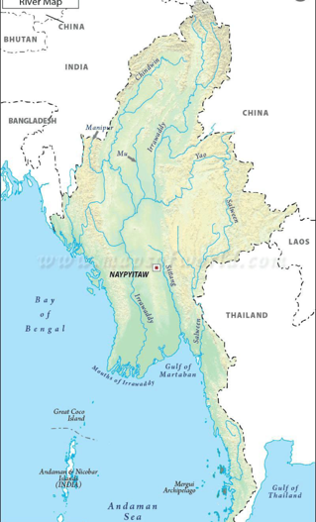
Introduction to Myanmar Agriculture

Slide 4
Myanmar agriculture in brief
Agriculture is the most important economic sector, and is essential for national food security, nutrition, and livelihoods of rural people
Contributed 23% of GDP and employed 60% of the labor force in 2017/18
Population is currently at 53.86 million, being the 24th most populous country in the world
Source: Planning Department, Ministry of Planning and Finance (2019)

Slide 5
Land resource and its utilization
Land Use | Area (mn ha)
Net sown area | 12.06
Fallow land | 0.46
Cultivable waste land | 5.54
Reserved forests | 18.88
Other forests | 14.50
Others | 16.21
Total | 67.65
There are about 12 mn ha of net agricultural land area, of which 34% or 4.2 mn ha are currently cultivated by small-scale farmers
A wide range of crop production systems are located in diverse soils and diverse climate (various agro-ecological zones), more than 60 kinds of crops are grown
Source: MOALI (2019)

Slide 6
Current situation of cassava industry

Slide 7
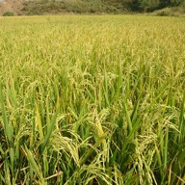
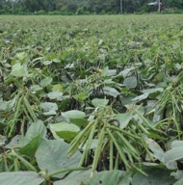
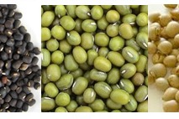
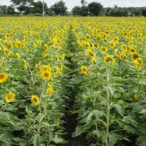
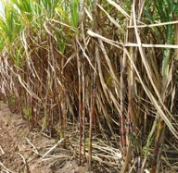

Cassava in Myanmar
Mainly grown by small-holders and the majority of farmers are owning less than 10 acres in Ayeyarwaddy region
In contrast, a few company plantations are very large farms over 10,000 acres (for example: Yuzana company in the Hukawng Valley area of northern Myanmar)

Slide 8
Cassava area, yield and production in Myanmar (2017/2018)
Region/State | Harvested Area (ha) | Average Yield (t/ha) | Production (t)
Ayeyarwady | 12919 | 14.87 | 192050
Bago | 185 | 20.25 | 3746
Chin | 86 | 4.15 | 357
Kachin | 16651 | 9.2 | 153158
Kayah | - | - | -
Kayin | 951 | 13.31 | 12654
Magway | - | - | -
Mandalay | 41 | 11.15 | 457
Mon | 295 | 14.39 | 4245
Rakhine | 316 | 6.25 | 1975
Sagaing | 1641 | 8.58 | 14073
Shan | 316 | 7.61 | 2404
Tanintharyi | 715 | 12.81 | 9156
Yangon | 602 | 18.49 | 11129
Total | 34718 | 11.68 | 405404
Data source: Department of Agriculture, MoALI 2018

Slide 9
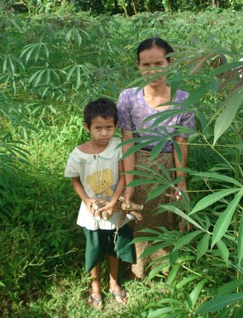
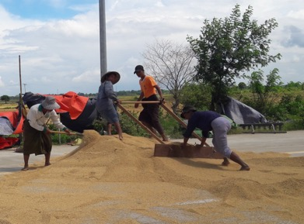
Rice vs Cassava
Rice is a priority crop in Myanmar for both national food security and export markets
Cassava is negalative crop
3rd most important crop in the delta region after rice and pulses

Slide 10
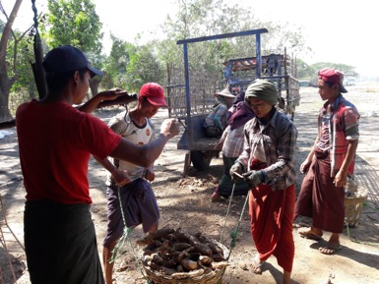
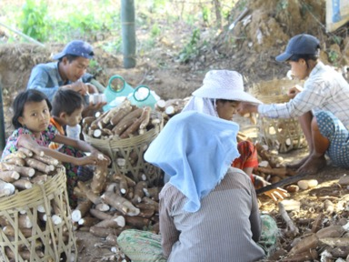
Potential role of cassava
Cassava is an important crop for both agro-industry development and export earning
Cassava industry creates many job opportunities for rural women to earn income for their families

Slide 11
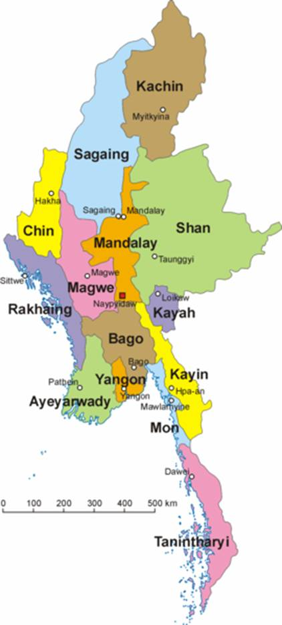
Current cassava industry
Starch processing is the main industry
Most of the processing factories are located in Ayeyarwady region

Slide 12
Daike Oo starch factory
It is state-owned factory in Daike Oo township in Bago region
Daike Oo factory formerly produced monosodium glutamate (MSG) in the 1980s before being transformed to a starch factory

Slide 13
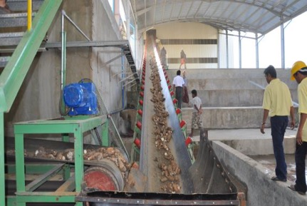
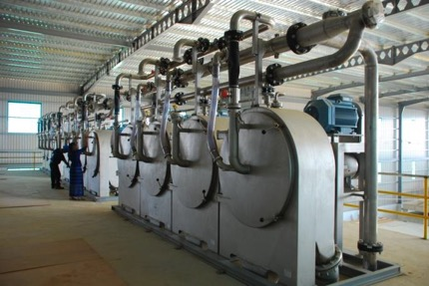
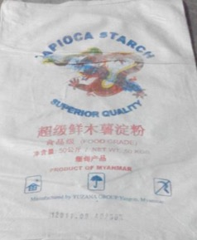
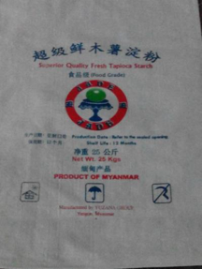
Yuzana starch factory
Processing capacity
(starch 600 ton/day production line since Jan, 2011)
Produces only for exports (mainly to China)

Slide 14
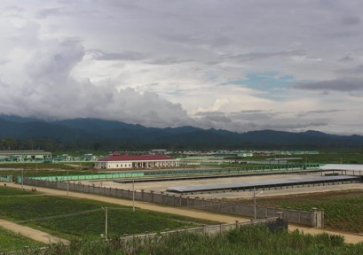
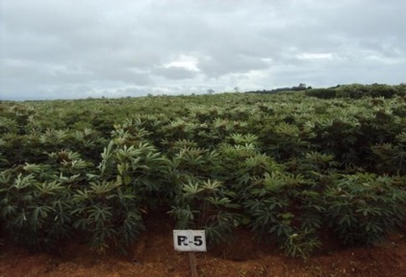
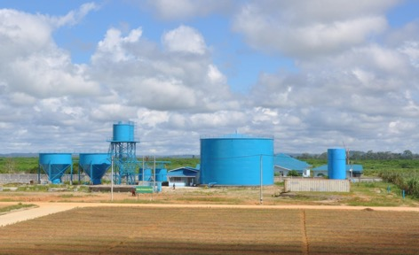
Yuzana cassava starch factory
Large plantation on concession land (100, 000 ha)
Utilizes modern technologies including waste water treatment

Slide 15
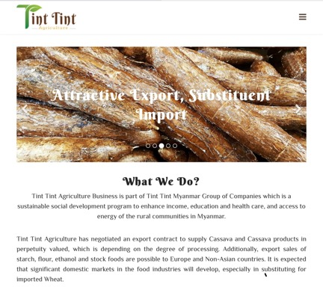
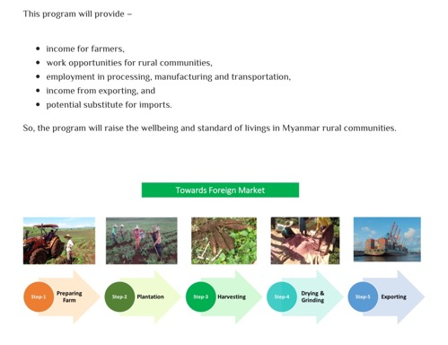
Tint Tint Agriculture
Large plantation union leased land (about 50, 000 ha)
Plan to process cassava flour and starch
Produces for both domestic and export markets

Slide 16
Cassava industry in Ayeyarwady
There are more than 200 cassava processors. 134 are registered processors that are part of the Cassava Growers, Millers and Traders Association (CGMTA)
Starch factories do not have access to electricity. Main power sources: diesel, rice husk and gas
Water source: deep-well and tube-well
Capacity : 1- 7 t of starch per day (most processing 2 t)
Total annual production capacity: 59,703 starch t/year
Processing season is usually started from Jan to April
According to our recent experiences, the starch processing period can be extended for at least 1 month (30 days)

Slide 17
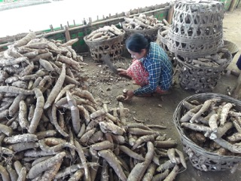
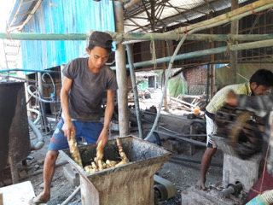
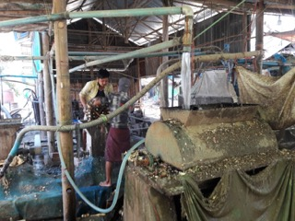
Starch processing operation
All factories own their cassava fields. Most starch factories, however, buy roots from growers in their neighborhood, directly or through agents
Three types of machine (peeling, grinding, and stirring machines) are commonly used to process the cassava roots
Employment size varies from 10 to 30 workers per factory

Slide 18

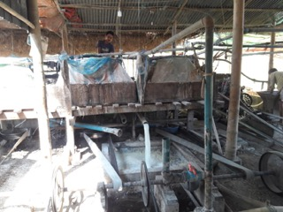
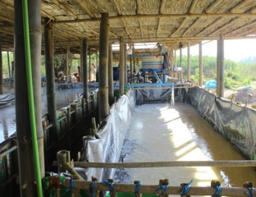
Starch processing operation (cont)
The roots are peeled by manually, then peeled roots are grinded and the starch extracted mainly by machine, but a few factories extract starch by hand
Settling tanks are made from Tarpaulin and lined with bamboo
Starch conversion rate from fresh roots varied from 23-35%, with an average conversion rate of 30%

Slide 19
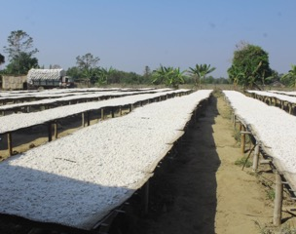
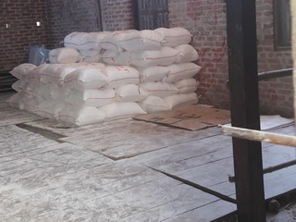
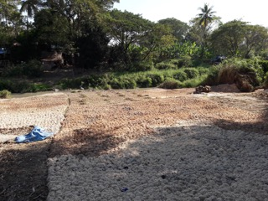
Starch processing operation (cont)
Wet starches are dried under sun (sun-drying)
Finishing and packing
Generally, residue from the starch processing was between 9-14 % of the fresh roots

Slide 20
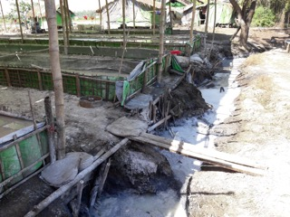
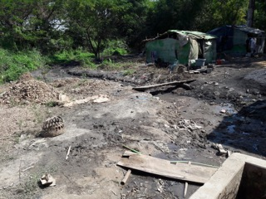
Starch processing operation (cont)
The maximum impact is at the site-specific level
Waste water is normally released directly to neighboring land , or is returned directly to streams
Lack of marketing research and technical expertise as well as processing technology make it an underutilized commodity and environmental risk

Slide 21
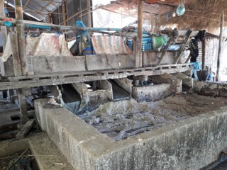
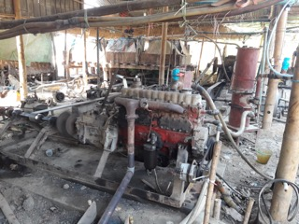
Outdated starch processing
Cassava industry sector is underdeveloped
Lack of investment in its industry compared to other industries such as rice and mining, etc
Lack of marketing research and technical expertise as well as processing technology make it an underutilized commodity

Slide 22
Growth prospects for cassava industry

Slide 23
Demand for cassava
Domestic demand has been increasing due to food industries and other related business in Myanmar consuming more cassava and its products
Export demands for cassava products to neighbouring countries such as China and Thailand are expected to increase considerably
The cassava industry would need to meet international standard requirements for value-added cassava products to gain entry into export markets

Slide 24
Major impacts of agronomic results
With new agronomic practices, an extra 7 - 10 ton of roots is generated which means:
More starch yield can be obtained from the same amount of high starch varieties of fresh roots. This results in more profit as well as lowering the production cost.
Reduces the risk of bad debt and fierce price fighting for fresh roots between processors in long run.
More root production means continuous-supply with potentially stable prices, because a very high root price can reduce competitiveness and can hinder the investors in the processing industry
These agronomic results enhance the competitiveness of Myanmar cassava industry and improves ability to access international markets.

Slide 25
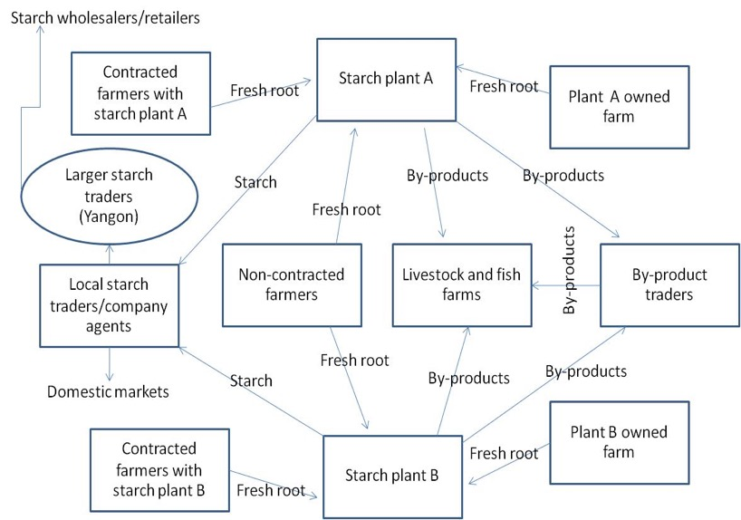
Cassava Value Chain Map, Ayeyarwady region, Myanmar

Slide 26
The potential of the cassava industry
Prospects for cassava industry in the immediate future are encouraging in Myanmar.
Process into value-added products at factories such as animal feed, modified starch , sweeteners, alcohol, and biodegradable plastic, etc.
But the future cassava industry will reflect current practices of cassava production and processing as well as markets of other alternative cassava products

Slide 27
Government engagement

Slide 28
Regional and National level cassava associations
The Cassava Growers, Millers and Traders Association (CGMTA) was formed at the regional level in 2015
Recently the Myanmar Fruit, Flower and Vegetable Producers and Exporters Association (MFVP) under the Union of Myanmar Federation of Chambers of Commerce and Industry (UMFCCI) has been discussed with CGMTA to form national level cassava cluster to operate the cassava products (chip and starch) purchases from farmers for the export
These associations are private institutions

Slide 29
There are several government agencies related to the agriculture sector. So far there is not much government engagement in cassava sector.
Critical issues include:
  No strategy for cassava sector development
  Lack of R&D and human resource in cassava sector
  Limited budget and weak logistic support for cassava sector
  Weak in coordination and cooperation among government ministries and development agencies
  Lack of regional and international collaborations

Slide 30
Further suggestions
Industry and government should engage in:
Developing national strategy for cassava sector in Myanmar
Better research and extension services, and capacity building
Infrastructure improvements; ensuring property rights; regulatory governance
Intervention of production and processing cost reduction policy
Improvement in credit helping farmers access to agricultural inputs
Providing loans to cassava processors and traders
Private and public partnership in cassava sector improvement
Empowering farmers and processors in production and business management skills
Supporting sustainable and profitable cassava production toward environmentally friendly products from cassava industry in Myanmar and beyond

Slide 31
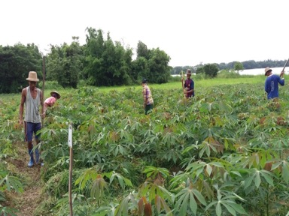



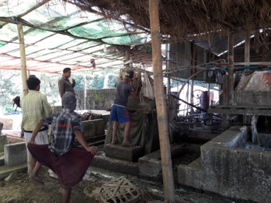


Sincere thanks!
DEPARTMENT OF AGRICULTURAL RESEARCH
DAR
Yezin, Myanmar

