Slide 1

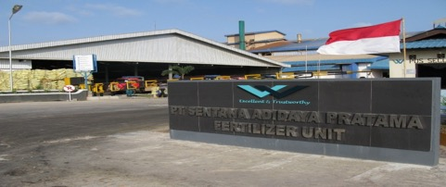



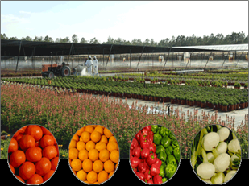
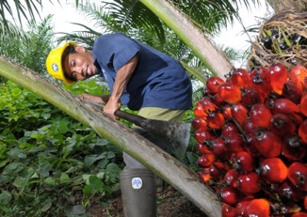
PT SENTANA ADIDAYA PRATAMA
PT. WILMAR CHEMICAL INDONESIA

Slide 2
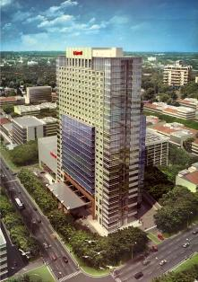
PT SENTANA ADIDAYA PRATAMA
PT. WILMAR CHEMICAL INDONESIA
PT. SADP Founded 1999 and PT. WCI 2013 in Indonesia
Are subsidiary company of Wilmar International Ltd, which focusing the business on fertilizer and agrochemicals (pesticide)
Head Office:
Multivision Tower
Jln. Kuningan Mulia 12 th-17th Floor
Jakarta
Indonesia
LO:
B&G Tower
Jln. Putri Hijau No. 10 7th Floor
Medan 20111
Indonesia

Slide 3

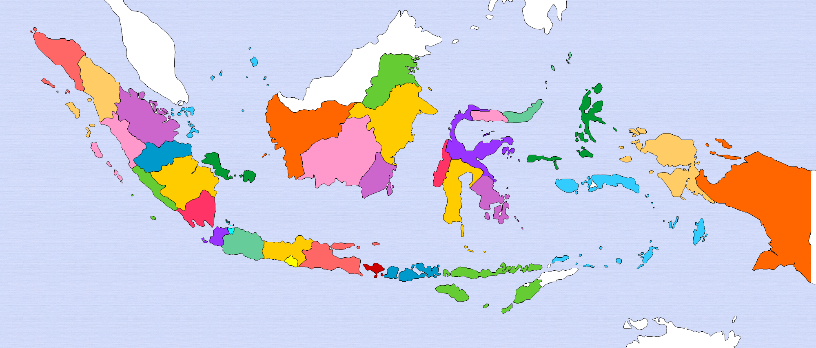
Bangka & Belitung
East Kalimantan :
- Samarinda
Riau :
Pekanbaru
South Kalimantan :
- Banjarmasin
North Sulawesi :
- Bitung
West Kalimantan:
- Pontianak
Jambi
Central Sulawesi :
- Palu
- Luwuk
North Sumatera:
- Medan-HQ
- RantauPrapat
West Sumatera :- Padang
Lampung
Central Kalimantan :- Sampit
Bengkulu
Jakarta-HQ
South Sumatera :
- Palembang
West Java
Central Java
East Java
Indonesian Map and Business Unit of PT. SADP/PT. WCI

Slide 4

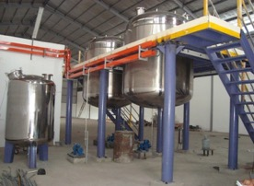
PT SENTANA ADIDAYA PRATAMA
Facilities
Factories
Fertilizer Unit:
NPK Plant 1, 2 & 3 → Pelintung-Riau
NPK Plant 4,5 → Gresik-East Java
NPK Plant 6 → under construction in Gresik-East Java
Total capacity 1200.000 tons per year
Pesticide Unit:
Herbicide → Medan-North Sumatera
Total capacity is 1.5 million litres per year and are planning to increase up to 2.5 million litres

Slide 5
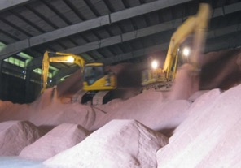
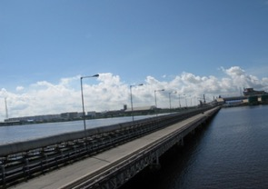
PT SENTANA ADIDAYA PRATAMA
Facilities
Warehouses:
Dumai, Pekanbaru, Padang, Jambi, Palembang, Pontianak, Kumai, Sampit, Banjarmasin, Samarinda, Palu, Semarang, Gresik, etc.
Jetty:
Pelintung-Riau
Gresik-East Java

Slide 6
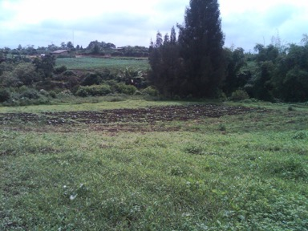
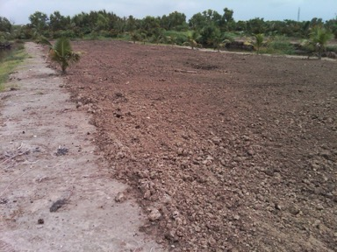
PT SENTANA ADIDAYA PRATAMA
Facilities
Field Trial Research Center:
Berastagi (1,2 ha for highland crops)
Medan-Marelan (10 ha for lowland crops)

Slide 7

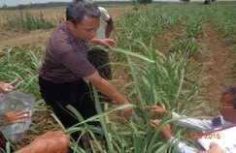
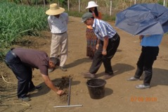
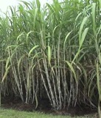


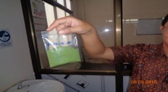
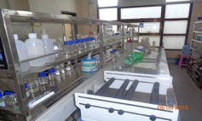
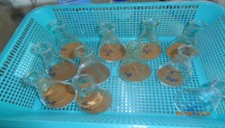
NUTRIENT’S BALANCED CONCEPT FOR MANURING RECOMMENDATION
Leaf Sampling Unit
Soil Sampling Unit
Dried Leaf
Lab Analysis Process
Dried Soil Composite
Manuring Recommendation

Slide 8
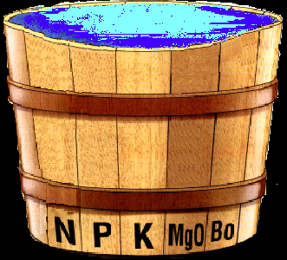
LIE BIG TEORY
NUTRIENT’S BALANCED
NO DEFICIENCY OCCURRED
BEST MANAGEMENT PRACTICED
TARGET PRODUKSI SESUAI DENGAN KELAS LAHAN AKAN TERCAPAI
OPTIMUM YIELD
ACHIEVED

Slide 9
CURRENT RESEARCH
Research and Product Development
Poly-4 (Natural Product K, Mg, Ca, S)
NEB-Root Exudates
Pro Plant C against Soil Born Desease Vector
Utilisation of Industrial waste as fertilizer raw filler material

Slide 10

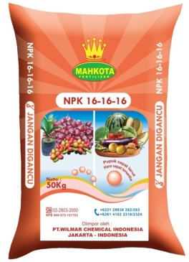
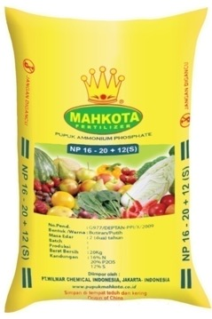
Best Solution for Agriculture
FERTILIZER PRODUCTS

Slide 11
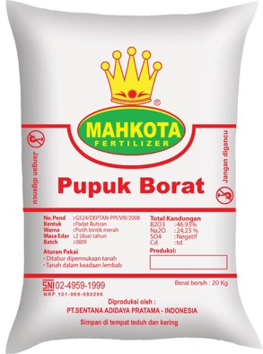
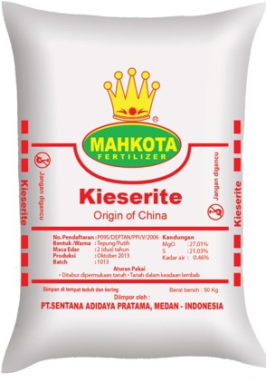
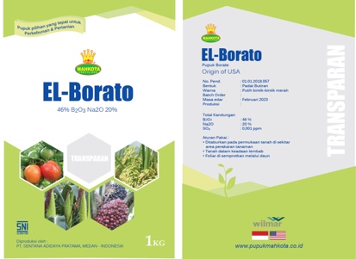
KIESERITE
BORATE

Slide 12
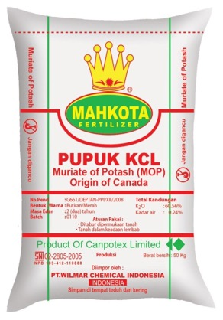
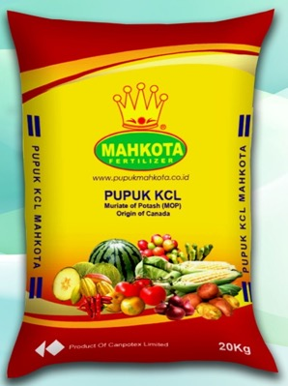
MOP-CANADA

Slide 13

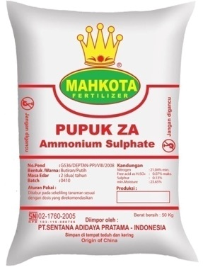
ZWAVELZURE AMMONIA (ZA)

Slide 14
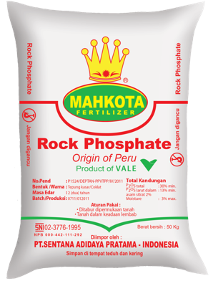
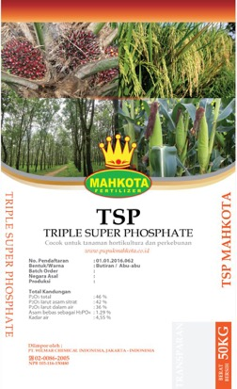


Slide 15

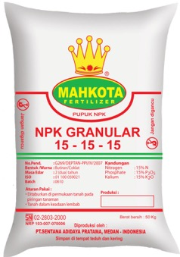
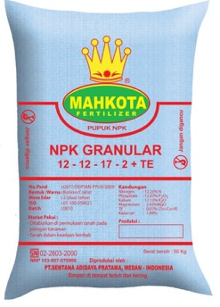
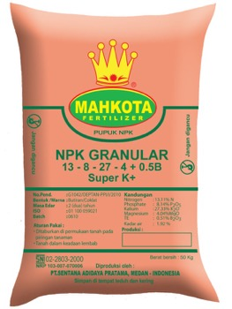
NPK GRADUAL RELEASED
NPK-MAHKOTA
15-15-15
NPK-MAHKOTA
12-12-17-2+TE
NPK-MAHKOTA
13-8-27-4+0.5B

Slide 16

Terima Kasih
Syaiful Bahri Panjaitan, S.P., M. Agric. Sc.
(Agronomic & Agroconsultancy Dept-Medan. HP: 081265035010)
Ramdhani (Marketing Development Dept-Jakarta HP:085223052122)
Wulan Rahmaini & Abdi Armaidi (Agronomist) Jambi)
DEPARTEMENT OF AGRONOMIC & AGROCONSULTANCY
PT. WILMAR CHEMICAL INDONESIA
SIANTAR 3rd JULY2019

