Slide 1





ENGAGEMENT WITH VALUE CHAIN AND POLICY ACTORS
INCREASING THE ROLE OF CHAIN ACTOR FOR CASSAVA
(Manihot Esculenta Cranzt) DEVELOPMENT IN EAST NUSA
TENGGARA, INDONESIA
Suhartini, Wani Hadi Utomo, Titiek Islami, Erwin Ismu Wisnubroto
University of Brawijaya
Research collaboration between University of Brawijaya, Balitkabi (ILETRI), ACIAR, CIAT, University of Queensland

Slide 2
Background Information
Cassava is one of the main crops in Sikka.
The average of farms size in Sikka Regency is 0.9 ha.
At higher elevations cassava is cultivated within an agroforestry cropping pattern and at lower elevations cassava is intercropped with maize and beans.
Farmers cultivate cassava for subsistence consumption, to sell as a food crop, and for livestock feed.
Cassava mainly used as food, whether consumed by farm-household or traded in local markets. Utilisation of cassava, are:
  30% for home consumption, including food and livestock feed
  20% sold directly to local market
  50% sold to traders
Farmers sell cassava gradually in small quantities (about 10-20 bundles, 1 bundle = 5-10 kg). There is no starch factory in Sikka Regency.

Slide 3
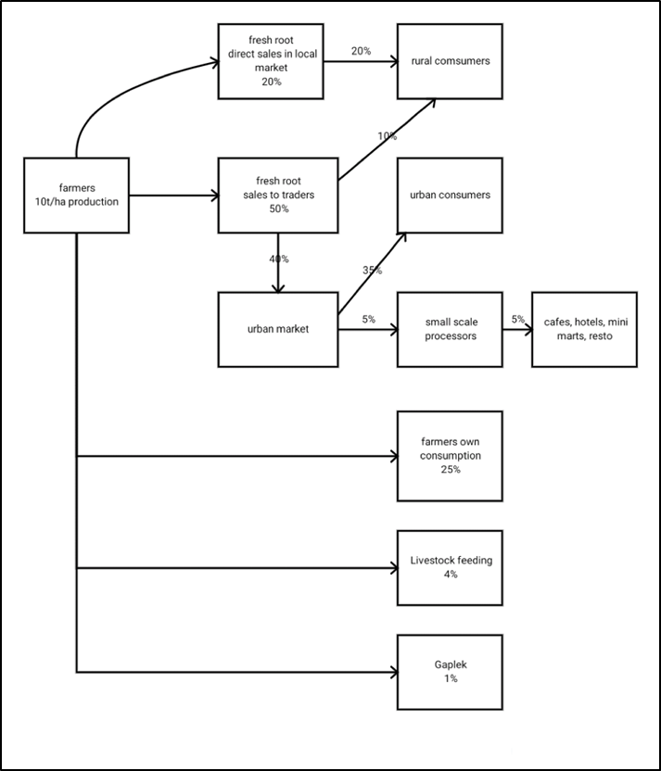

Slide 4
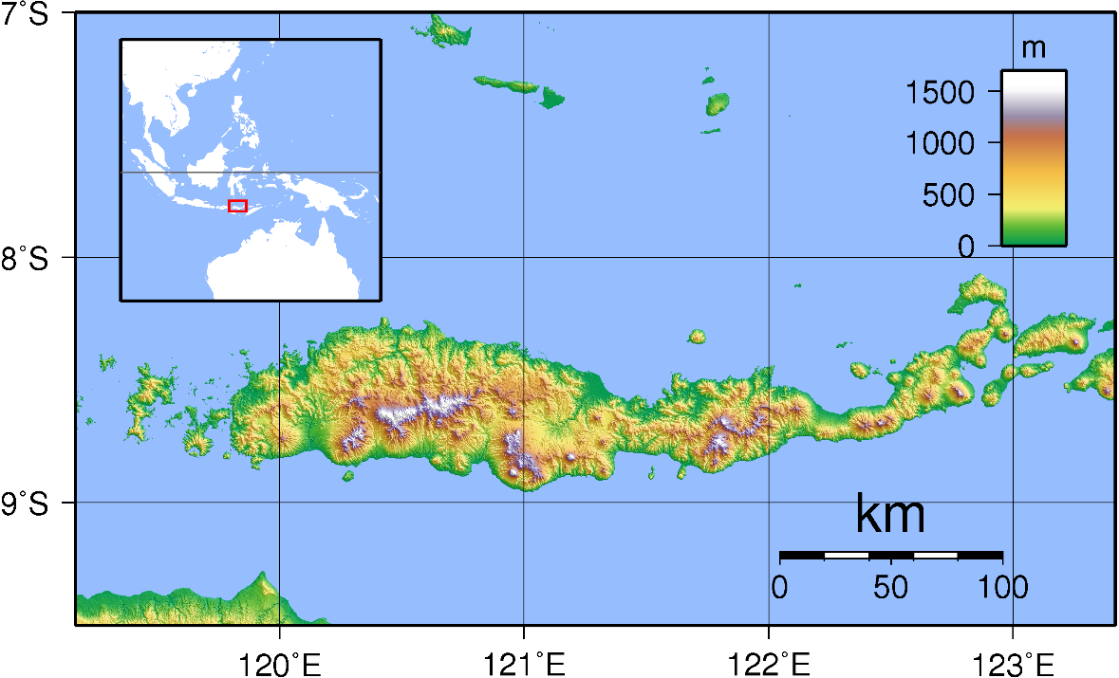
Flores, East Nusa Tenggara (NTT)

Slide 5
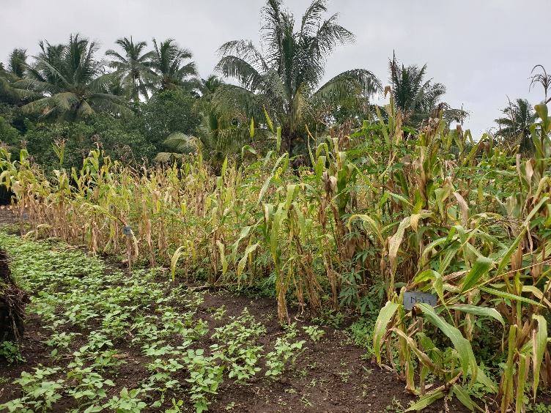
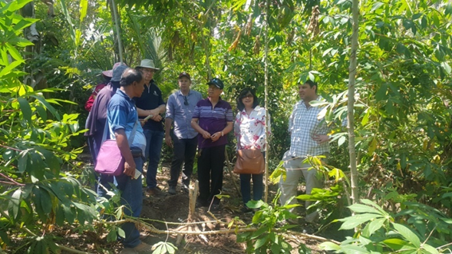
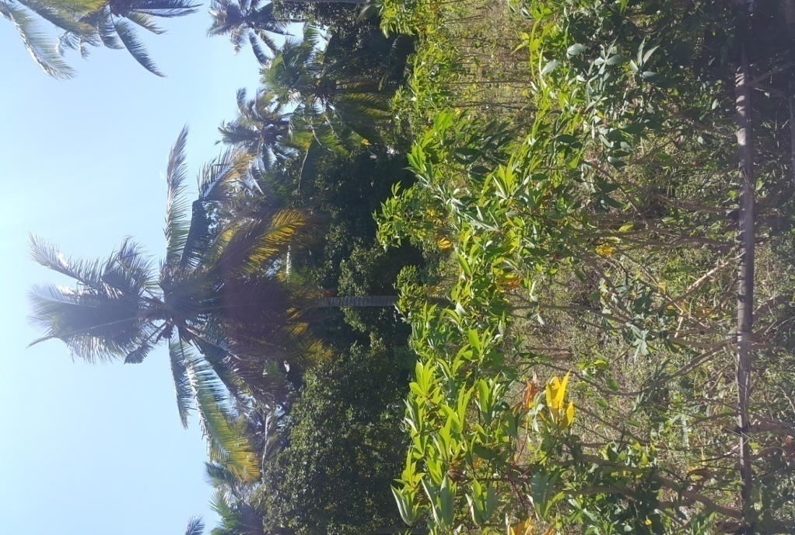
Cassava in agroforestry cropping at the upland (higher elevation)
Cassava (local variety) in agroforesty system with coconut, cacao, cashew, tamarind, banana, lontar palm, candlenut (kemiri), pepper, nutmeg (pala), mango, avocado, maize
Filed experiment ACIAR:
Cassava, maize and mung bean at low land (lower elevation)

Slide 6
What technologies were prioritised? Why
Farmer’s Adoption
Technological Assistance
Dissemination of agronomical trial and workshop
In 2018, there were 26 farmers from Sikka, 2019: 40 farmers from Sikka participated in the project by adopting the improved technology demonstrated by the project (new varieties and improved cropping system).
Project help with the seeds (cassava and maize), fertilizers, and supervision (in cooperation with the Field Extension officer). Because maize is the main food for East Nusa Tenggara people, all farmers planted cassava in between their maize crops.
The improved technology demonstrated by the project (new varieties and improved cropping system) have choosen because of the farmers in Sikka plant local cassava variety with low productivity.

Slide 7
What were the opportunities identified
The opportunities identified in Flores NTT are
01
The regional government will support for cassava development in NTT, with The Agricultural Agency, local government, and field farm extension. The government supports are: Subsidy for fertilizer, maize seed, tractor
02
The trader will buy the farmers cassava, and it will be processed to cassava chips for as raw material for animal feed.
04
The farmers will be planting cassava.
03
The Universities and research institutes provide research, development, and technology that will help farmers.

Slide 8
What were the constraints
The constraints were identified are:
- the limitation of water on dryland
- the limitation of farmers capital for farming system
- there are no starch and no feed factory in NTT.

Slide 9
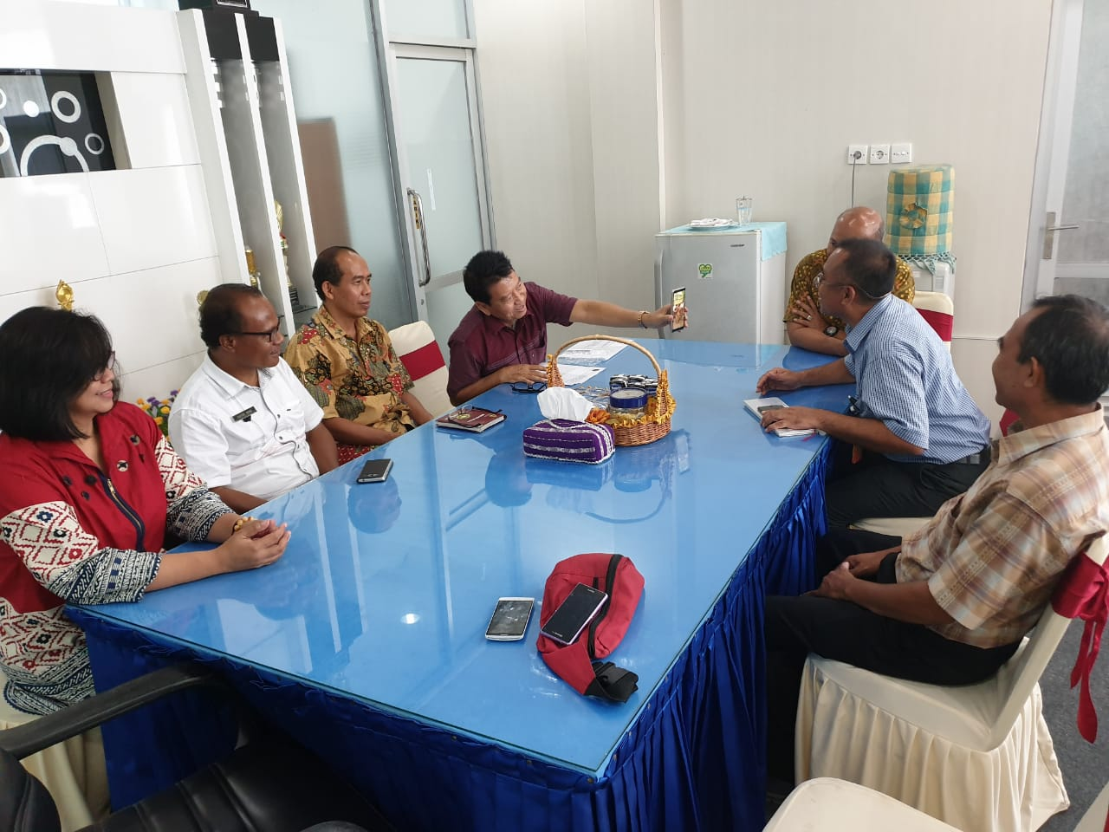
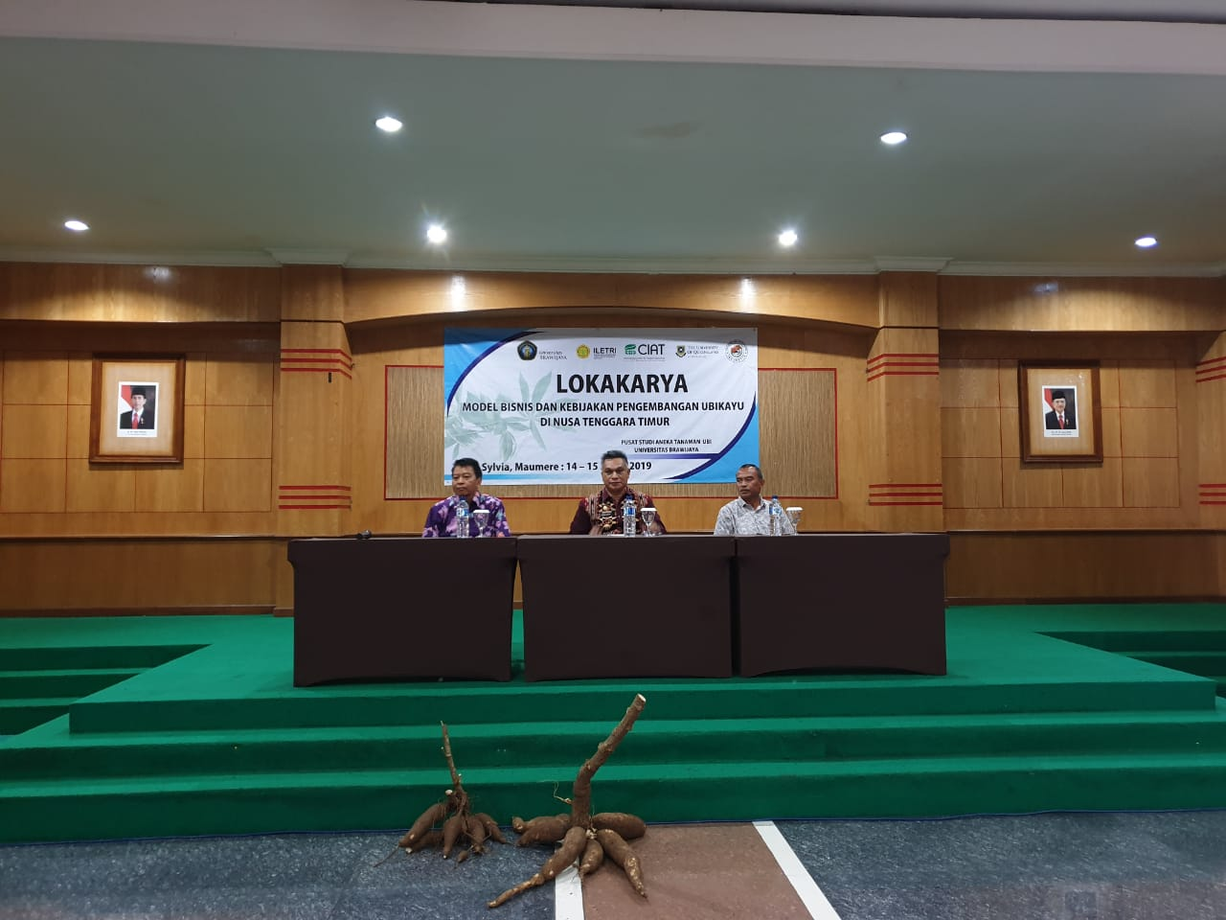
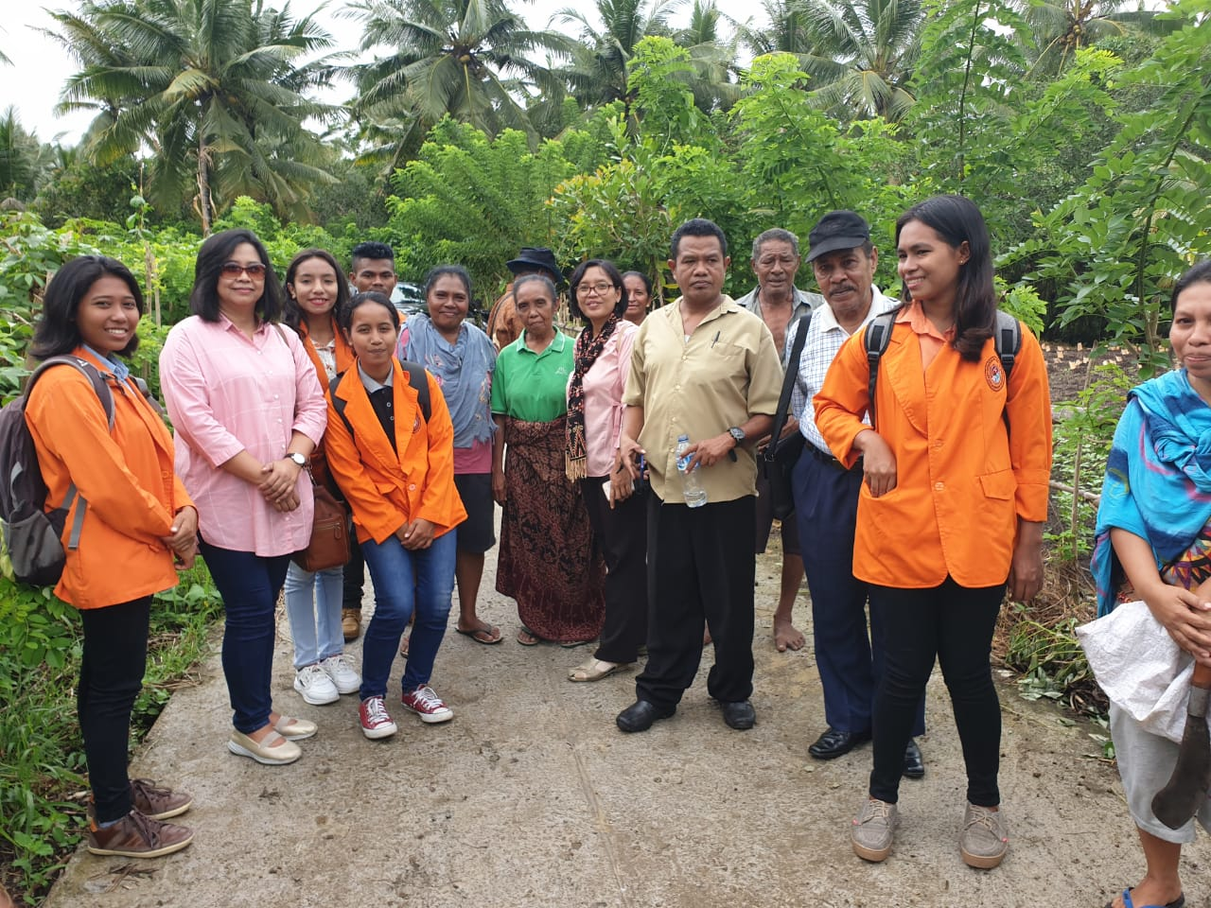
What has been done
Field experiment
Technologies adoption process
Consultation to the regional and local government
The trader engagement to buy cassava farmers
Giving support to the trader

Slide 10
What is the current outcomes
What succeeded
There were 26 farmers from Sikka in 2018 and 40 farmers from Sikka in 2019 participated in the project by adopting the improved technology demonstrated by the project (new varieties and improved cropping system).
There are 40 Farmers have been adopting the technologies in the East Flores region
There are other district in NTT has been interesting to adopt
the technology
What failed
- About 20% of farmers achieve production only 1-5 – 2 kg/tree,
because of the limitation of water

Slide 11
Who in the value chain could capture benefits
The farmers get benefits those are the new technologies which are new varieties, fertilizer application, farming system technologies to improve cassava productivity
The trader get opportunities for buying farmers cassava and it be processed to cassava chips for feed
The regional government will get the benefit from the farmers income increasing.

Slide 12
Is it now sustainable without a project?
To enhance the sustainability of cassava development, there is need the effort to expand the land area of cassava to other districts in Flores, subsidies for farmers include fertilizer subsidies, develop the business model with win-win solutions and develop the cassava processing.

Slide 13
What needs to be done in the next 12 months?
Continue in supporting for farmers on cassava technologies adoption
Continue in supporting for trader
Continue in stakeholder engagement
Evaluate the socio economic aspect of the project.

Slide 14
Thank you

