Slide 1




Developing partnerships with public and private sector for scaling cassava production technologies in Lao PDR
Chanphasouk , Laothao Youabee¹, Phanthasin Khanthavong², Saythong Oudthachit², Jonathan Newby¹,

Slide 2
Outline
Key points from yesterday
Cassava market chains in Laos
Activities have been done.
Example on lead firm – monopsony working with DAFO and
Ongoing funding model developing.

Slide 3
Summary from yesterday
‘New’ varieties produce higher fresh root yield and starch yield especially in areas of significant CWBD
Attractive rates of return on low balanced fertiliser application
Adoption of practices would lead to improved household income.
Who has an incentive to demonstrate technology to farmers?

Slide 4
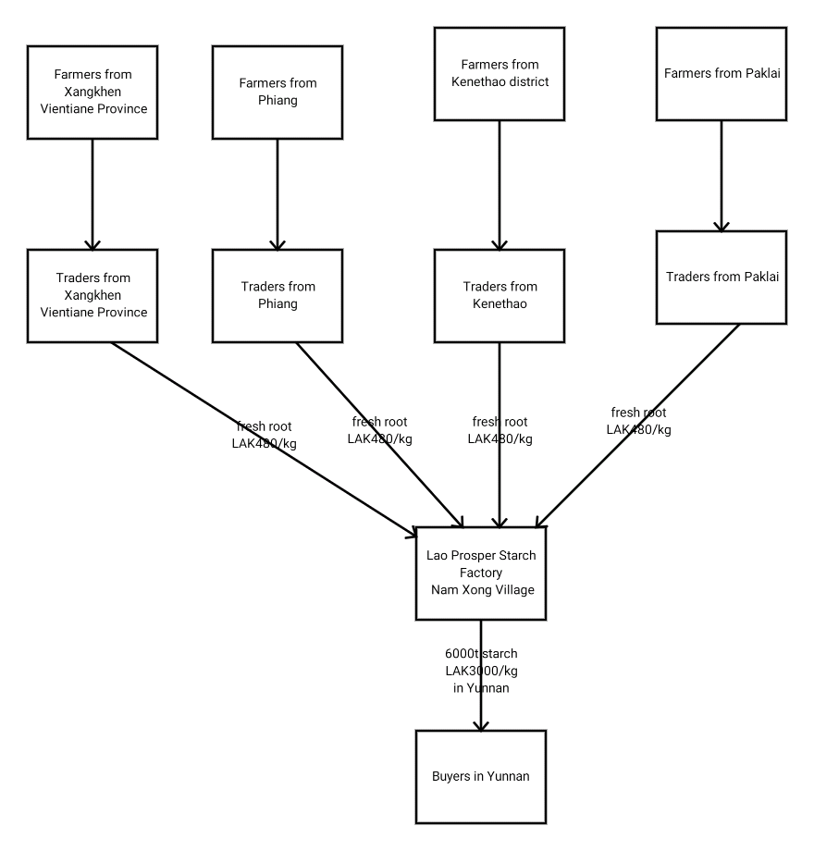
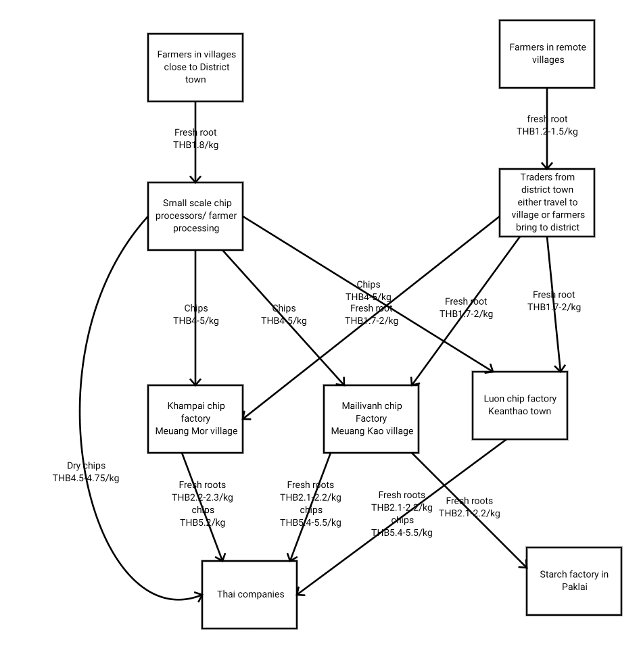
Structure of the value chain varies between sites and is dynamic in Lao sites
Paklai, Xayabouli
Kenthao, Xayabouli

Slide 5
What has been done?
Harvest field days with farmers, government, and value chain partners.
Follow up focus groups with farmers to report agronomic and economic results to farmers
District level stakeholder meetings with village leaders, district and province agricultural staff, private sector, finance sector
Partnership with fertiliser import company
National level dialogue
Link to development projects ongoing

Slide 6
Cassava stakeholders
 | Paklai | Kenthao | Bolikhan | Viengthong
Farmer groups | NA | NA | NA | NA
DAFO | Extensionnists | Extensionnists | Extensionnists | Extensionnists
Traders | collectors | Collectors | collector | collectors
Factories | Starch factory |  | Starch factory Chip factory | Starch factory
Input suppliers | KP Lao is registered importer of Crown and Rabbit head fertiliser
NGOs | NA | NA | LuxDev Helvetas | LuxDev

Slide 7
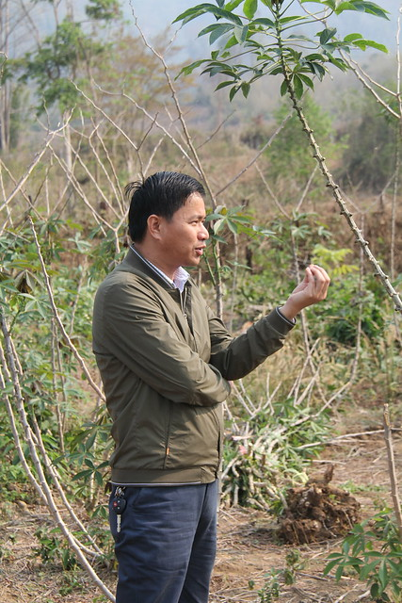
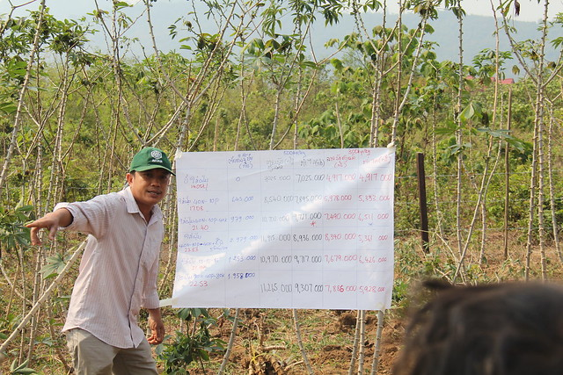
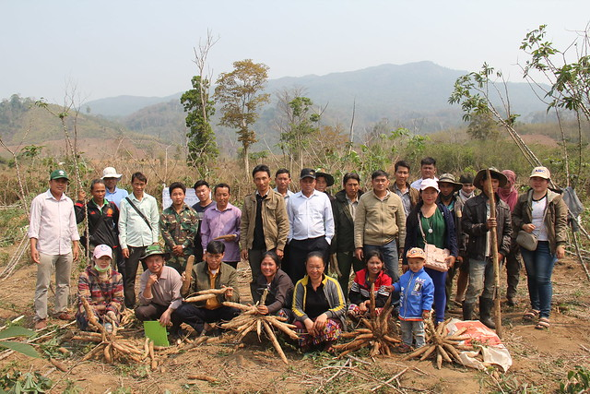
Harvest field days involving private sector
Factory manager

Slide 8
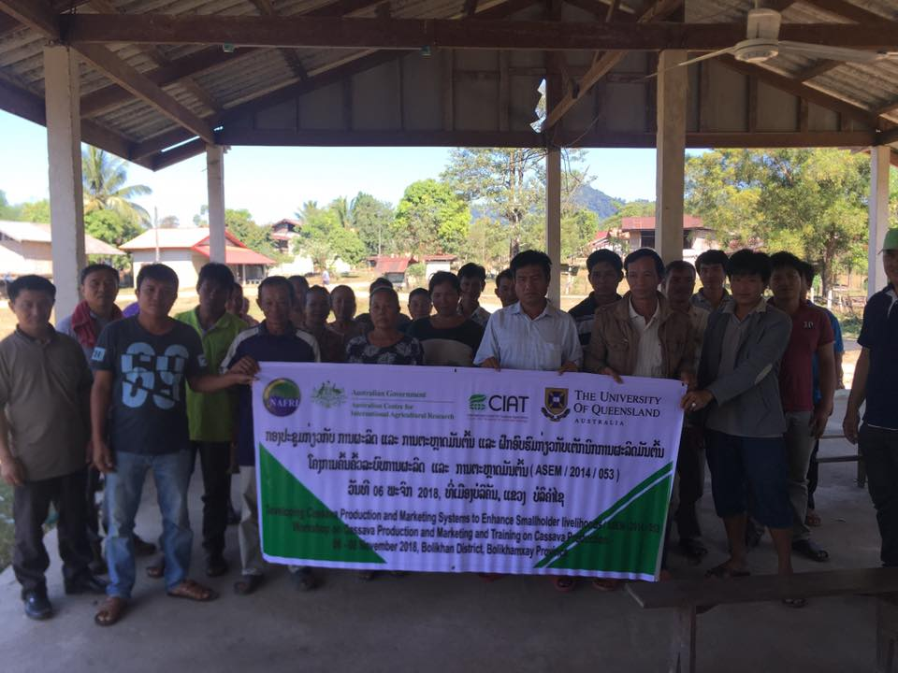
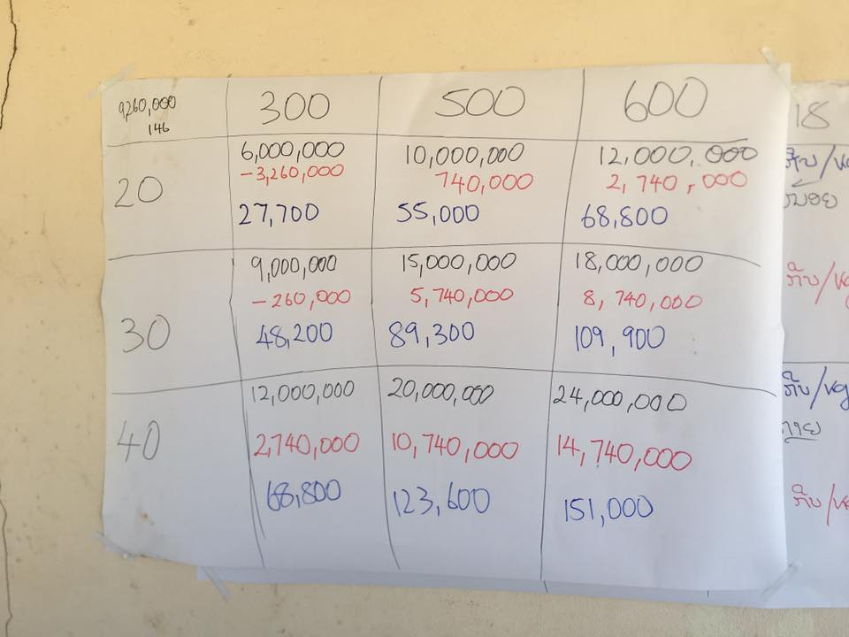
Focus group meetings for feedback on results and scenario analysis

Slide 9
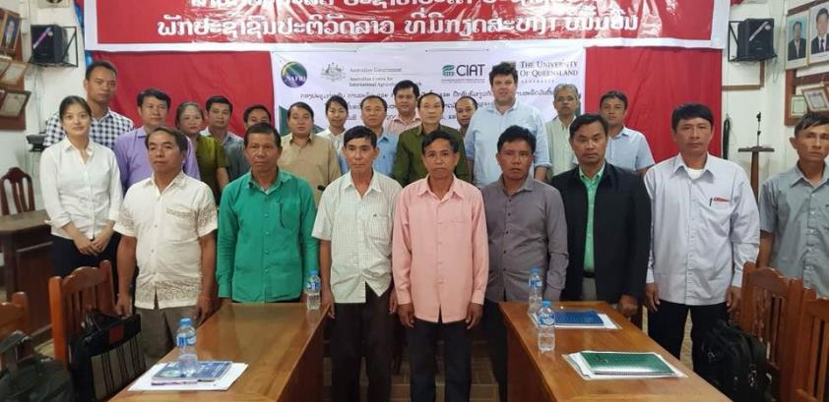
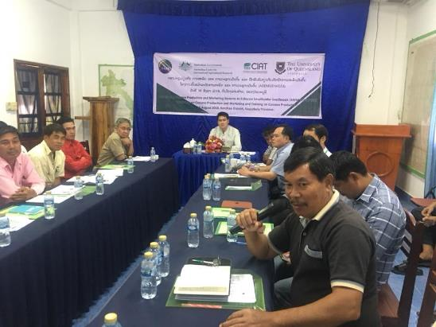
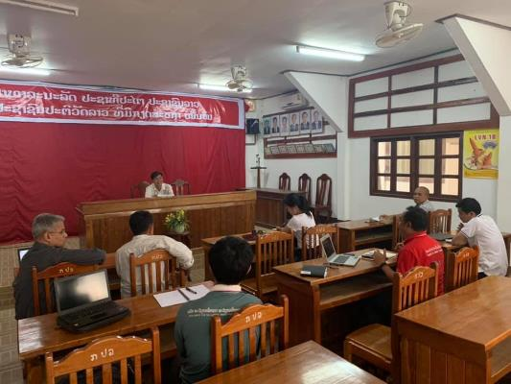
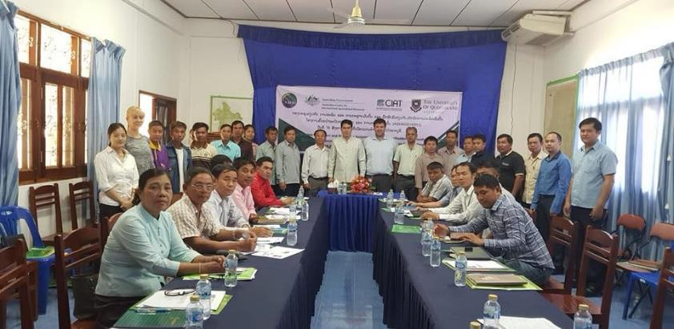
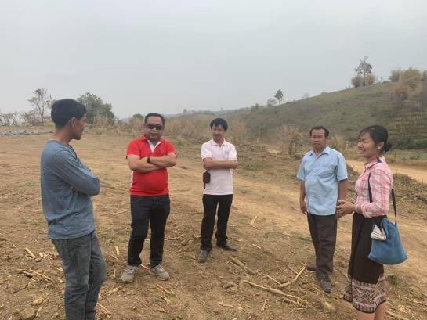
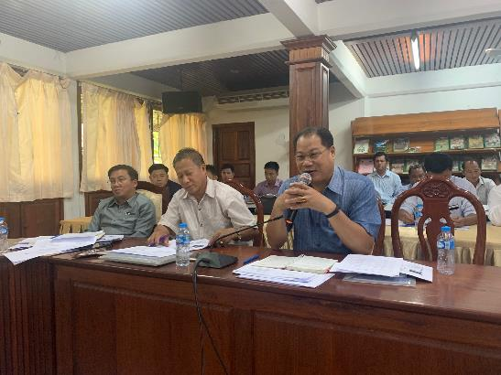
Multi-stakeholder engagement at local and national scale

Slide 10
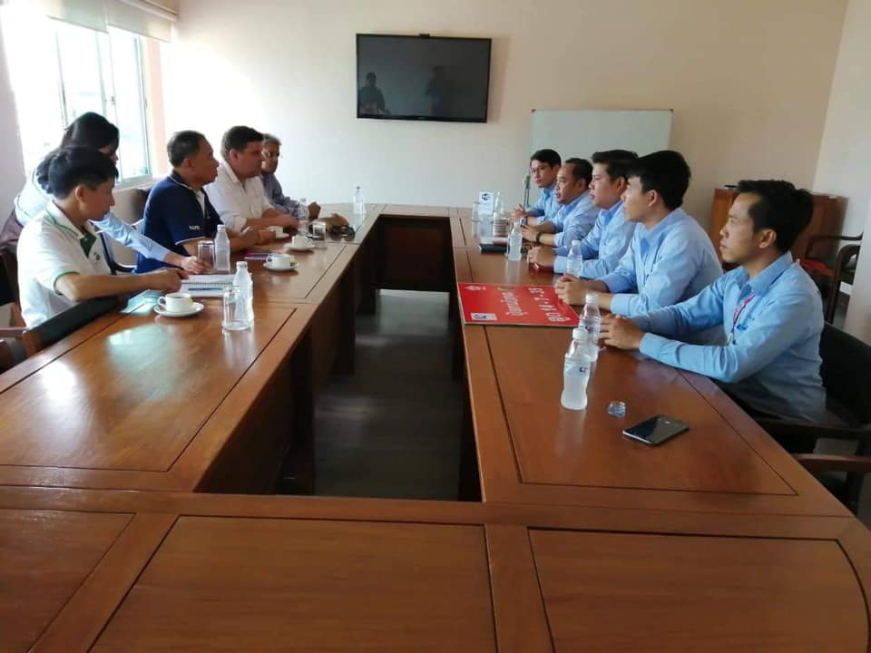
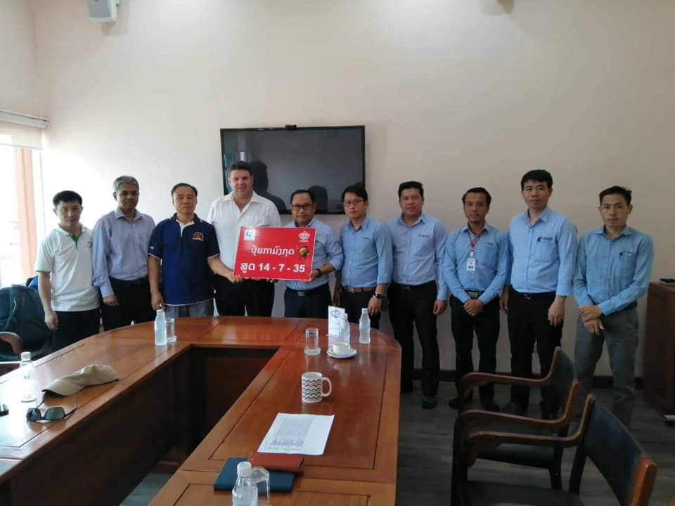
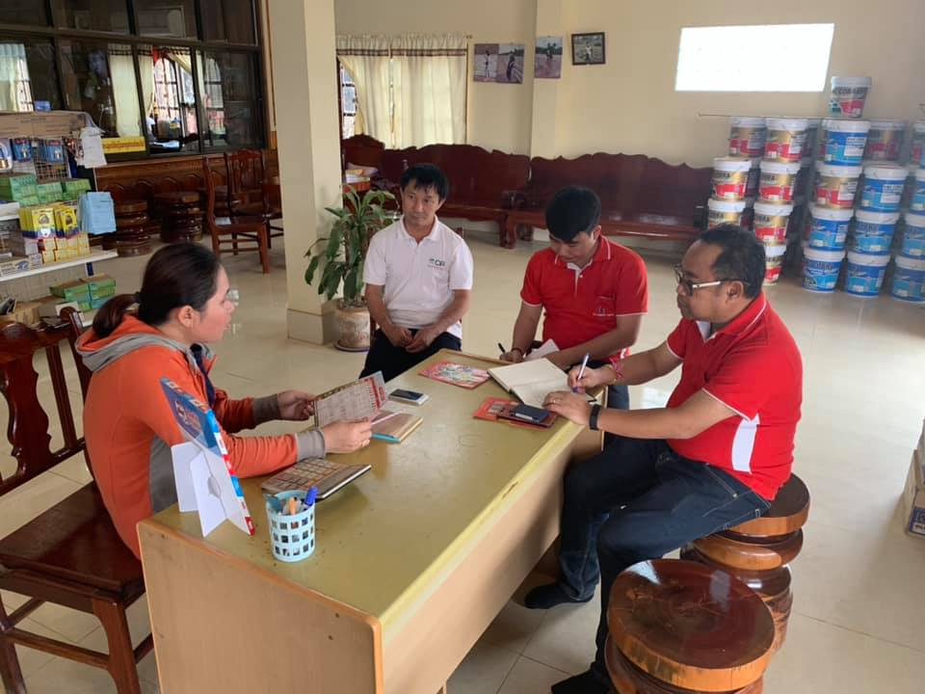
Partnership with fertiliser importer

Slide 11
Training of District staff and farmer leaders
Participants | Paklai | Kenthao | Bolikhan | Vienthong
Government officer | 18 | 17 | 19 | 17
Famer | 28 | 22 | 24 | 27
Factory | 1 | -- | 1 | 1
Dry chip company | -- | 2 | 1 | --

Slide 12
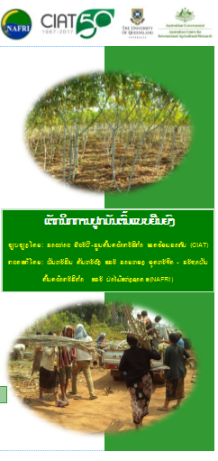
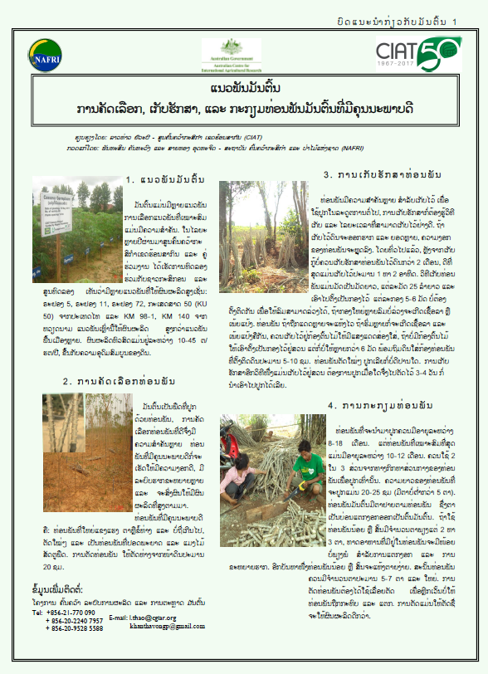
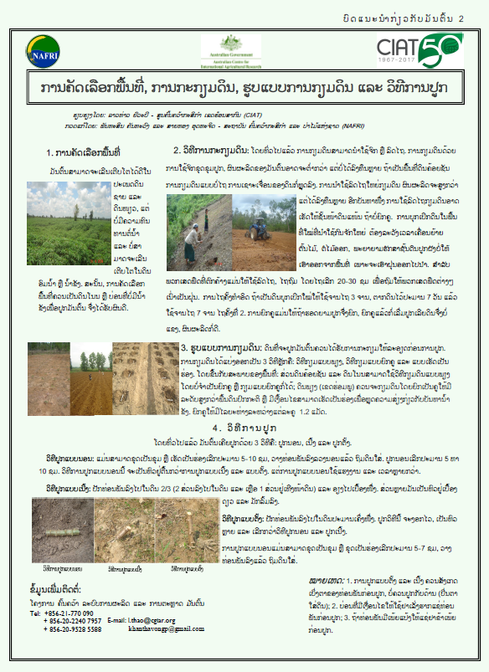
Extension posters and Leaflet

Slide 13
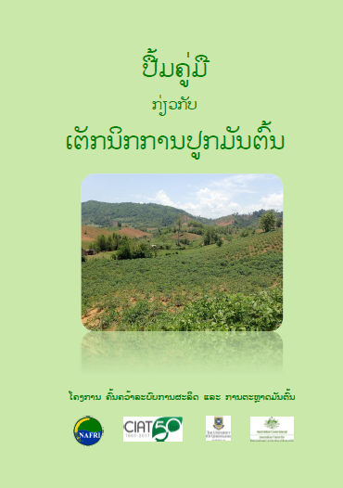
Training Manual

Slide 14
Expansion of activities
Year 3
Year 2
Fertilizer demonstration
Fertilizer demonstration
Fertilizer trials
40 farmers fertilizer use demonstration trials
One Intercropping demonstration trials
2 fertiliser trials
Multiplication at NAFRI and Districts
Preliminary yield trial in 2019-20 of 5 clones
Year 1
16 farmers fertilizer demonstration trials
2 fertiliser trials
Variety distribution
Multiplication of stems at NAFRI and districts
CIAT introduced 42 new clones to Laos
4 fertiliser trials
4 variety trial
Multiplication at NAFRI
Replicated trial
Fertilizer demonstration
Intercropping
Variety trials
Replicated trial
Replicated trial

Slide 15
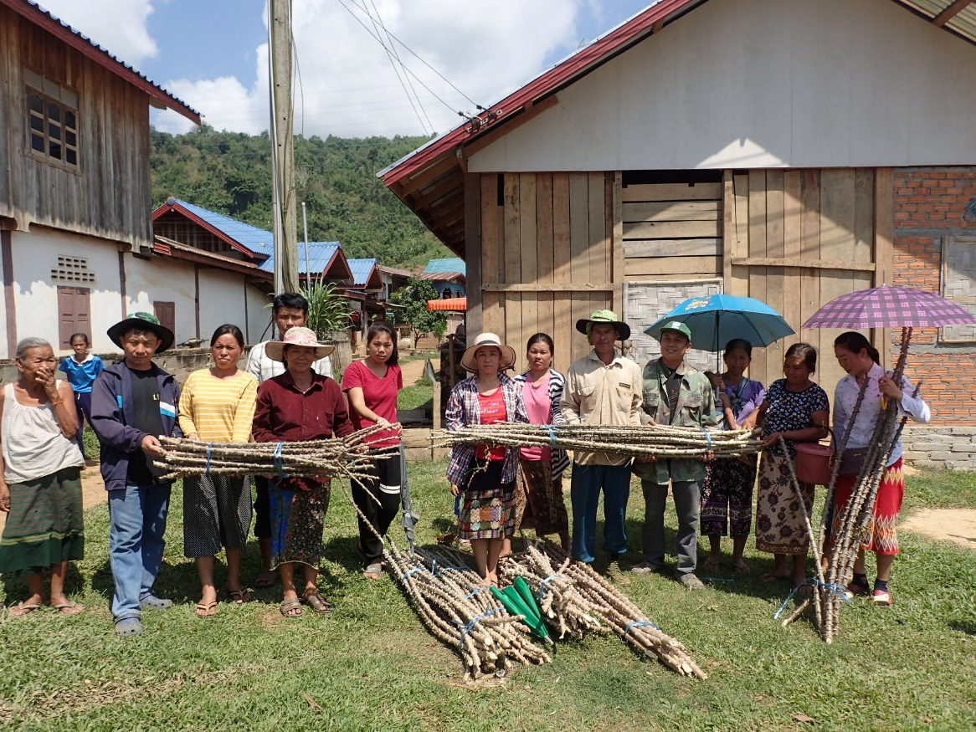
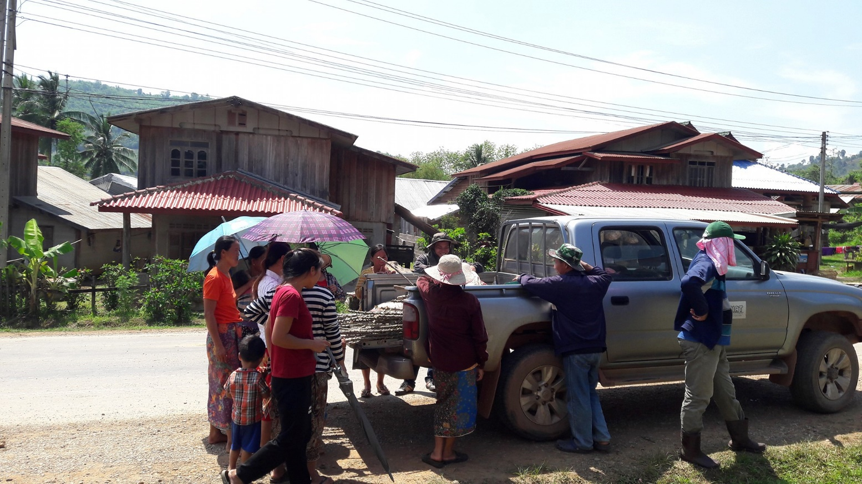
Distribution of Rayong 11 in target villages

Slide 16
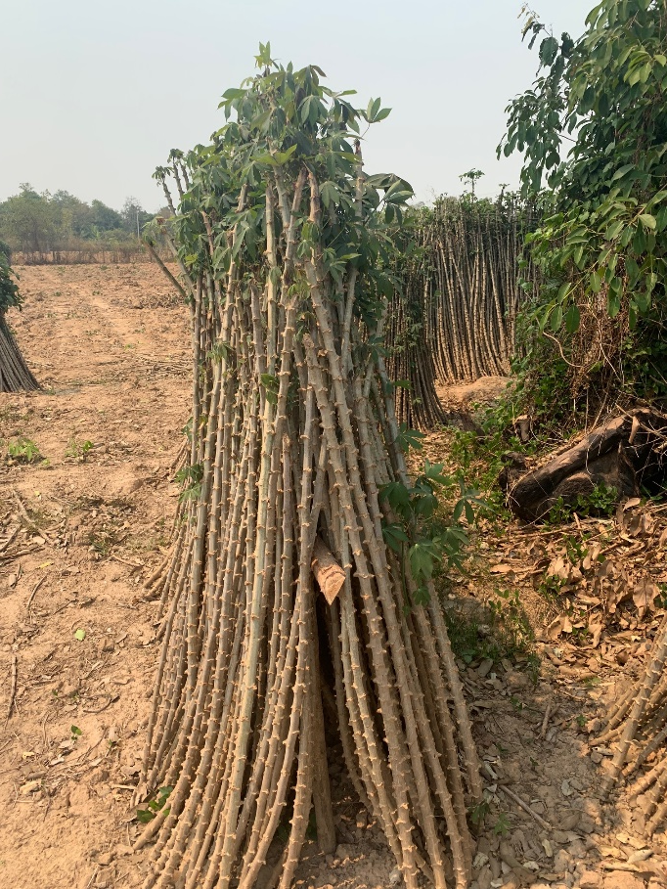
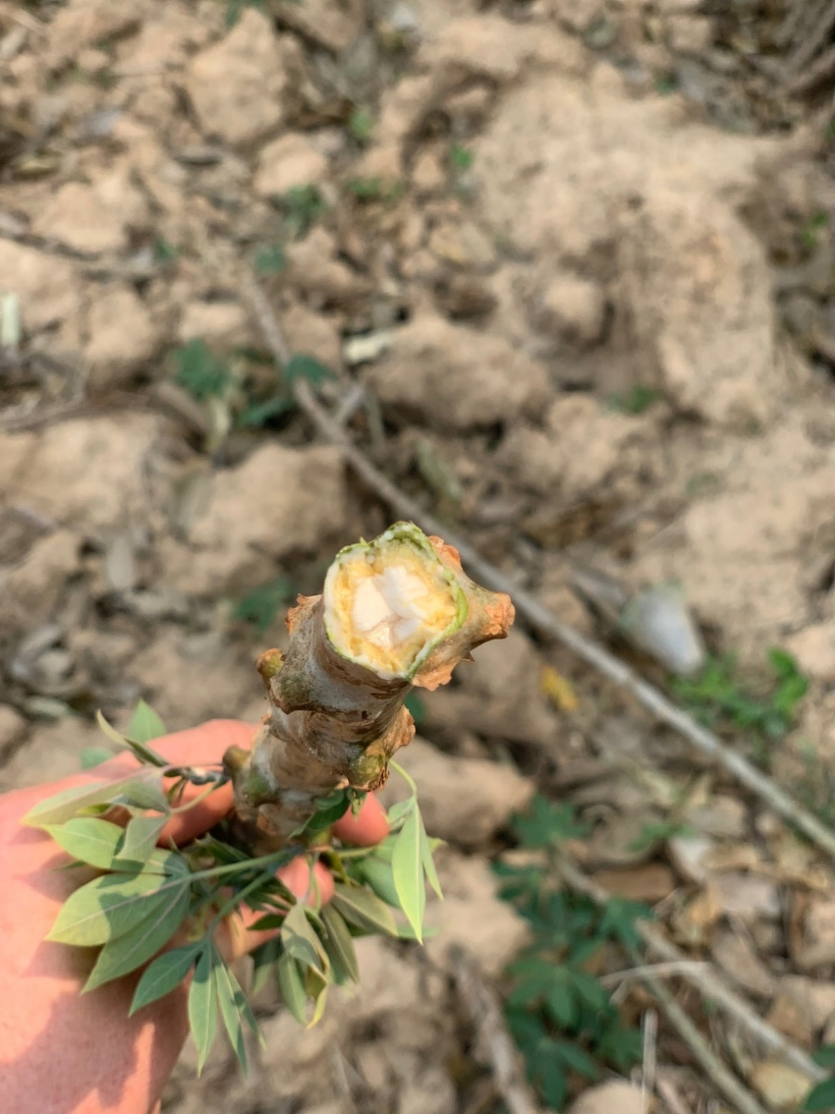
Seed system and exchange of planting material
Expansion of area creating demand for stems
3M LAK per ha of stems ($340 USD)
Movement of CWBD around the country and potential import of CMD a threat.

Slide 17
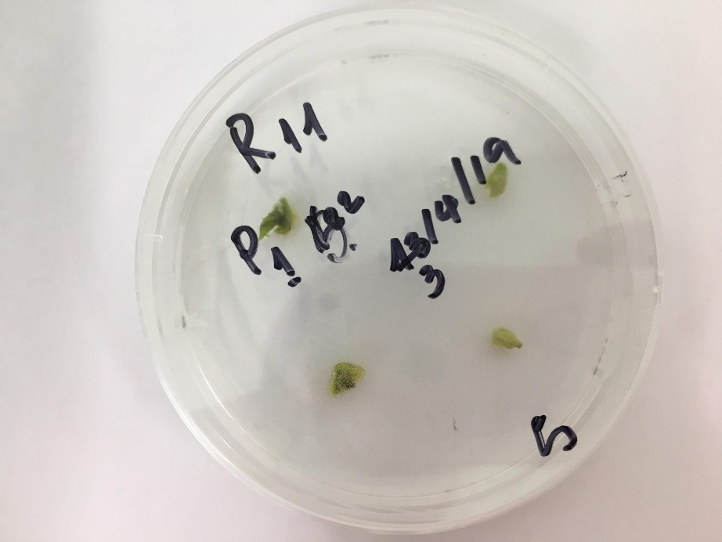
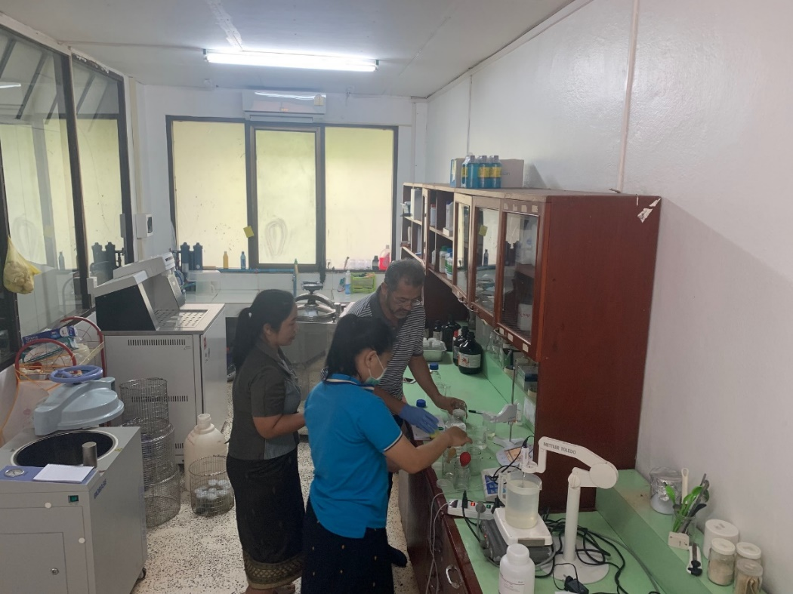
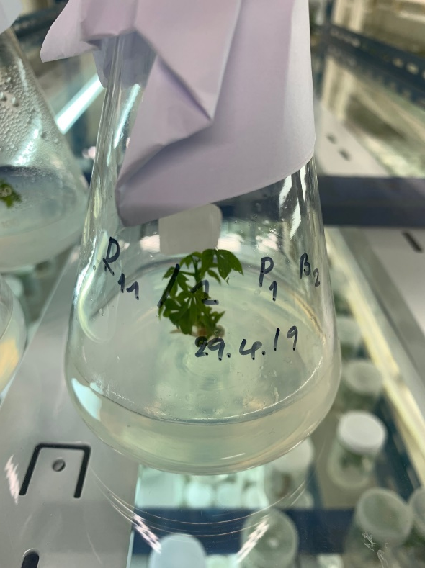
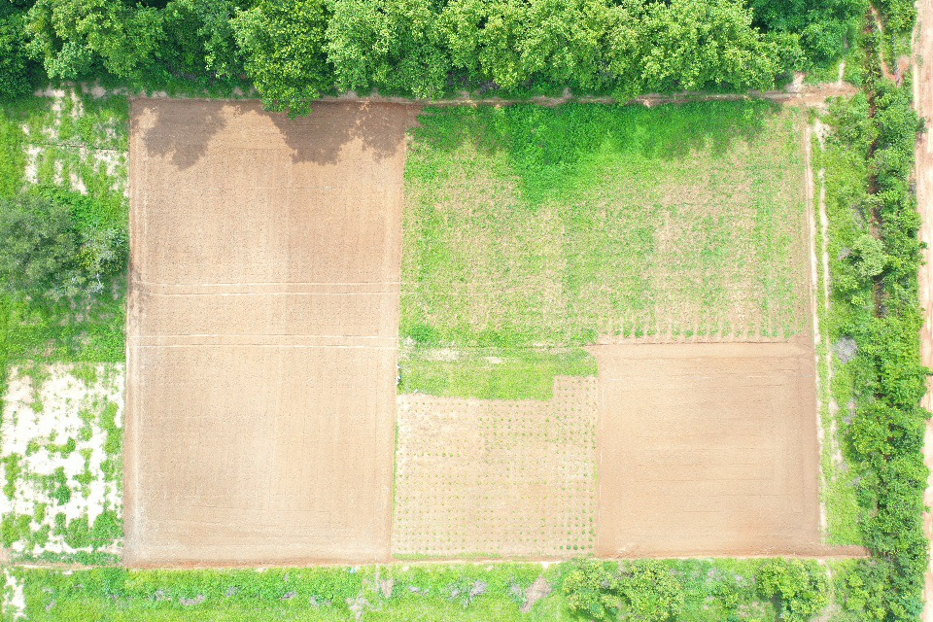
Developing source of clean planting material funded by new ACIAR project

Slide 18
Lead firm – monopsony working with DAFO (example from Paklai)
Farmers
Factory

Slide 19
Lead firm – monopsony working with DAFO (example from Paklai)
$500 USD
Farmers
Factory
10t/ha
2-2.5 t of starch
5kip x 10,000
$6.25 USD
Export
Demonstration
$100 USD
DAFO

Slide 20
There is 15,000 ha of cassava in Paklai…..even at 25% adoption
$1,875,000 USD
Farmers
Factory
10t/ha
2-2.5 t of starch
5kip x 10,000
$23,438 USD
Export
Demonstration
$375,000 USD
DAFO

Slide 21

There is 15,000 ha of cassava in Paklai…..even at 25% adoption
$1,875,000 USD
Farmers
Factory
Sales
10t/ha
Fertiliser company
2-2.5 t of starch
5kip x 10,000
$23,438 USD
Export
Demonstration
$375,000 USD
Fertiliser
DAFO
40 demonstrations

Slide 22
Village banks – farmers loaning funds for cassava production
Village Bank
NGO
savings
Retail store
loan
Farmers
Factory
Fertiliser company
Export
Demonstration
DAFO
Fertiliser
40 demonstrations

Slide 23
Multiple firms in same supply zone
Factory
Factory
Farmers
Factory
Fertiliser company
Export
Demonstration
DAFO

Slide 24
Developing public – private funding models for research and extension
We are in the process of developing business models and funding models in target districts and value chains.
There are several activities that need to occur at a national scale to maintain the productivity of the Lao cassava sector that cannot be depend on projects.
  Breeding and selection is a long-term activity requiring stable resources
  Pest and disease monitoring and surveillance
  Clean seed production
  Market information and intelligence

Slide 25
THANK YOU

