Slide 1

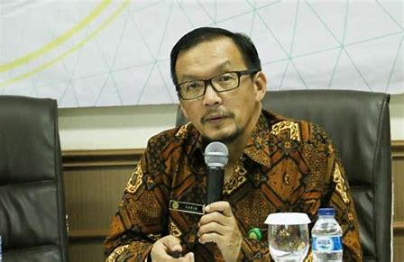
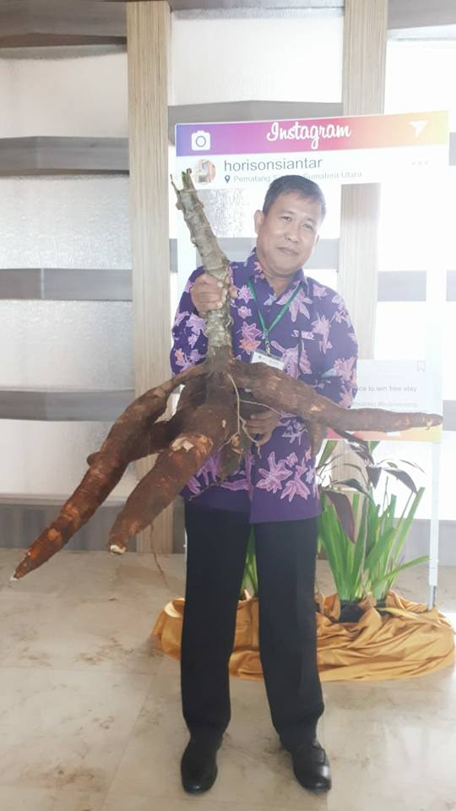
Dr. Haris Syahbuddin
Head of ICFORD
Dr. Fadjry Djufry
Head of IAARD
Dr. Yuliantoro Baliadi
Head of ILETRI

Slide 2
Cassava policies and priorities
in indonesia
Fadjry Djufry, Haris Syahbuddin, Yuliantoro Baliadi
& Kartika Noerwijati
INDONESIAN AGENCY FOR AGRICULTURAL RESEARCH AND DEVELOPMENT
MINISTRY OF AGRICULTURAL THE REPUBLIK OF INDONESIA
WORKSHOP ACIAR CASSAVA VALUE CHAIN
Pematang Siantar, 1-5 July 2019

Slide 3
Existing Condition of CASSAVA IN INDONESIA
At present, cassava is not a priority commodity in the ministry of agriculture program.
Focus of activities are still achieving self sufficiency for paddy, corn, soybean, onion, meat, sugar, red chili, coffee, cocoa, palm oil, and rubber.
Cassava actually has an important role in supporting food security and food diversification in Indonesia.

Slide 4
Cassava has high yield potential, high carbohydrate, tolerant to drought, tolerant to poor soil, so it has enormous potential to support food security in Indonesia and even the world, because Indonesia has set a target for 2045 as the world’s food barn. Cassava and other tubers crops will play an important role.
By considering the important of the function of cassava as food, as raw material for various industries, and cassava has high economic value, it is expected that cassava can become national priority comodity besides rice, maize and soybean.

Slide 5
CASSAVA EConomiC VALUE
The cassava harvested area in Indonesia in 2015 reached 949,916 ha with a total production of 21.8 million tons, if the price of cassava was IDR 1,000 / kg, the value would reach IDR 21.8 trillion.
If calculated following derivative products, the trade value of cassava can reach IDR 100 trillion, defeating soybeans about IDR 20 trillion.
(Ahmad Subagyo, 2017)

Slide 6
Cassava in Indonesia
FAO (2017): The main cassava producers in the world: Nigeria (55 M tones), Thailand (31 M tones), Indonesia (20 M tones).
Sumber: Kementan ( 2018)
Cassava main producer area

Slide 7
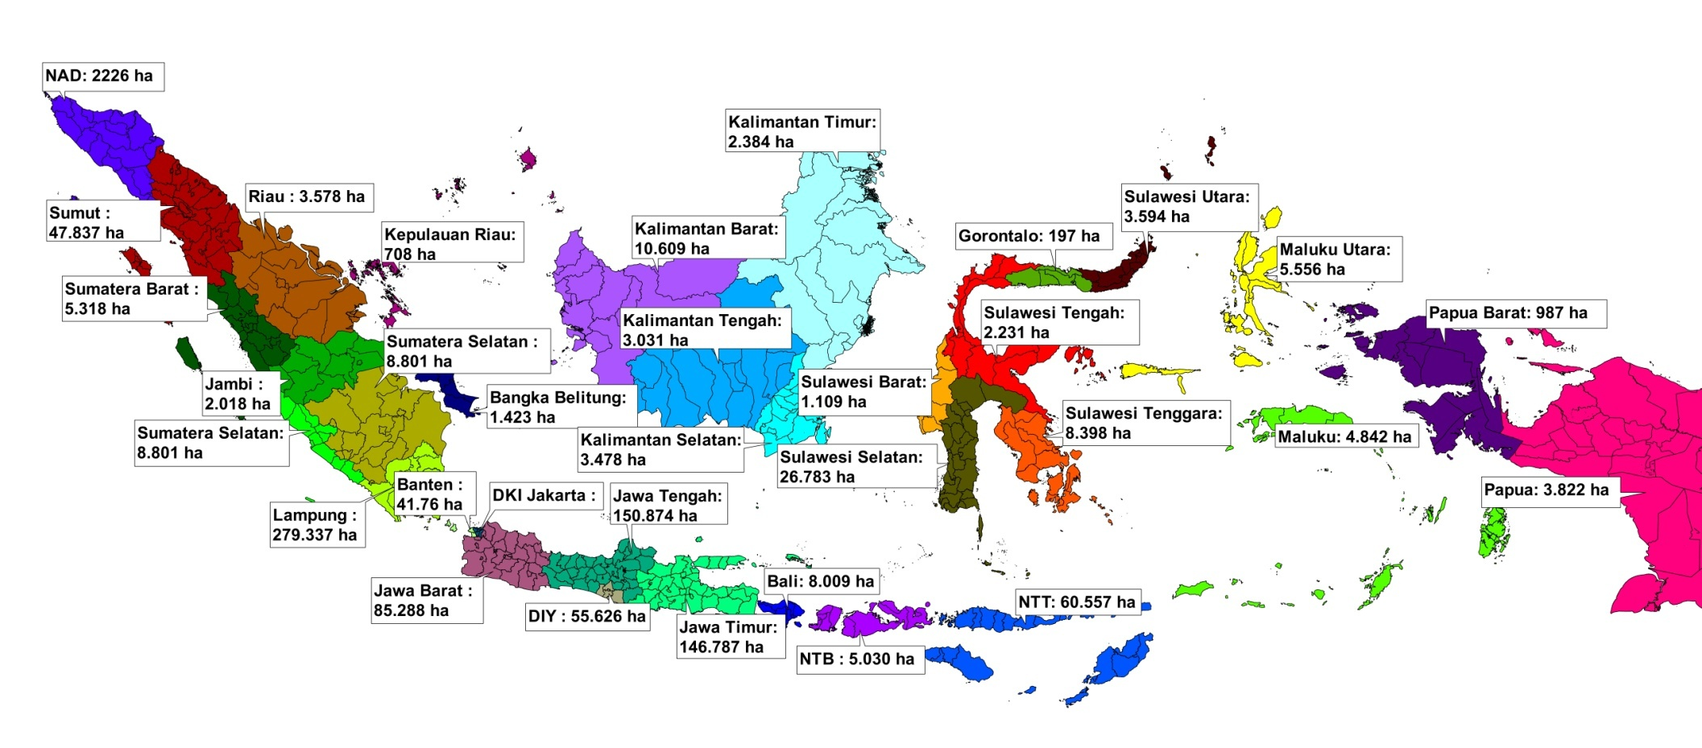
Cassava PRODUCTION Area in Indonesia
TOTAL AREA IN 2018: 792,952 Ha

Slide 8
Trend of cassava production
Year | Harvested area (ha) | Growth (%) | Productivity (kw h⁻¹) | Growth (%) | Production (Ton) | Growth (%)
2014 | 1,003,494 | - | 233.55 | - | 23,436,384 | -
2015 | 949,916 | (5.34) | 229.51 | (1.73) | 21,801,415 | (6,98)
2016 | 822,709 | (13.39) | 246.26 | 7.30 | 20,260,276 | (7.07)
2017 | 772,975 | (6.05) | 246.50 | 0.10 | 19,053,748 | (5.96)
2018 | 792,952 | 2.58 | 243.91 | (1.05) | 19,341,233 | 1.51
Avg | 868,409 | (5.55) | 239.95 | 1.15 | 20,778,611 | (4.62)

Slide 9
PRODUCTION AND UTILIZATION OF CASSAVA 2018
CASSAVA | VOLUME
PRODUCTION Productivity Total demand | 19,341,233 tones 24 t/ha 23,157,000 tones
UTILIZATION: Direct consumed (3.2 kg/capita/year) Food industry Feed Loss | 12,759,000 t (55.1%) 9,403,000 t (40.6%) 481,000 t (2.1%) 513,000 t (2.2%)

Slide 10
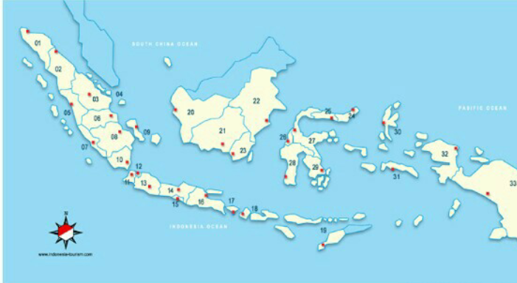
Cassava Varieties distribution 2013-2017
Adira 1, Adira 4, Malang 1, Malang 4, Malang 6, UJ3, UJ5, Darul Hidayah, Litbang UK2, UK1 Agritan

Slide 11
Malang 4 is the most widely distributed variety
Total cassava seedlings distributed over the last five years
from ILETRI (by varieties)

Slide 12
CASSAVA PROBLEMS
Switch to other commodities, such as corn and horticulture commodities.
There is no guaranteed price, thus reducing the interest of farmers to cultivate cassava.
The increasing volume of tapioca imports and derivative products in the past five years.
There are no regulations that protect the commodity of cassava.

Slide 13
Cassava Development Policy in Indonesia
Increase cassava production
Developing cassava agribusiness in an integrated manner by developing the role of the private sector, cooperatives and state-owned enterprises
Support the movement to increase food diversification
Increasing capital sources that are easily accessible to farmers
Improve cassava commodity trading that is conducive to farmers

Slide 14
S T R A T E G Y
Productivity improvement
Use of superior variety
Application of good cultivation technique
Use of balanced fertilizers
Controlling plant pest organisms that
envronentally friendly
f) Adaptive to climate change
Setting planting time
Post harvest handling
PRODUCTIVITY
IMPROVEMENT
STRATEGY
1
2
EXPANSION OF AREA AND
LAND MANAGEMENT
Land optimization
Increase in IP
Expansion of planting area
PRODUCTION
SAFEKEEPING
Controlling plant pest organism &
impact of climate phenomena
Reduction in yield loss
3
Policy and Regulation support
Improvement of the agricultural
credit system
c) Improvement of data and information
d) Improving the coordination of
the central, regional and all stakeholder
MANAGEMENT
IMPROVEMENT
4

Slide 15
CASSAVA PARTNERSHIP PATTERN
Installment payment
Business feasibility aspects
BANK
PRIMERY COOPERATION
CORE
FARMERS
AGREEMENT
NOTES
Net income
PLASMA
FARMERS
Cost production
Marketing

Slide 16
TECHNOLOGY AND ACTIVITIES TRANSFER
Compilation of General Guidelines, determined through a Decree of the Minister of Agriculture as Budget User
Compilation of Technical Guidelines, determined by Budget User Proxies at the Central level, Provincial Service and District Agriculture Service
Socialization of activities, a meeting was held and coordination with relevant agencies. Socialization of planning, implementation of programs and activities as well as data and information management carried out in stages by the Directorate General of Food Crops, Provincial, District / City, District and Field Agriculture Service Offices

Slide 17
CAPITAL
Government assistance sourced from APBN funds, both for purchasing inputs and guidance activities
Food and Energy Security Credit Scheme issued by the Finance Directorate of the Directorate General of Agricultural Infrastructure and Facilities
Collaboration with private parties / investors / other sources

Slide 18
FARMER GROUPS INSTITUTION AND EDUCATION
The development of cassava commodities uses the means of farmer groups that have been formed and are still active, the head has been established (tasked with coordinating the activities of group members), the secretary (task of recording activities carried out at each meeting) and treasurer (responsible for dealing with financial issues)
To ensure the implementation of development, it is necessary to try at least one person from the farming group as a motivator who is able to provide a rapid response to innovation and is able to encourage other group members to provide the same response.
Groups of cassava commodity development will conduct observations together at the development site, describe and discuss the field findings. The field guide acts as a facilitator to direct the course of group discussions. The development farmer group must follow each planting stage and apply a combination of technological components that are appropriate to the specific location starting from tillage, cultivation, handling of harvest and post-harvest. At each stage of implementation, participating farmers are expected to carry out a series of activities that have been planned and scheduled at the location of cassava commodity development.

Slide 19
THE IMPLEMENTATION OF CASSAVA PRODUCTION TARGET ACHIEVEMENTS
Seed / nursery
Provision of quality certified / superior cassava seeds, in coordination with the Directorate of Food Crops and ILETRI in Malang.
2. Agricultural Infrastructure and Facilities
Support for infrastructure, infrastructure and agricultural facilities, coordinating with the Directorate General of Agricultural Infrastructure and Facilities, especially in the allocation of subsidized fertilizers as well as assistance in agricultural farm machinery and post-harvest equipment assistance with the Directorate of PPHP Directorate General of Food Crops and other related agencies.
Improvement of Human Resources (HR)
To support the improvement of agricultural human resources, coordinate with the Provincial and District / City Counseling Coordination Board and other relevant agencies in a). escort and assistance in managing cassava production, b). increasing competency through training apparatuses and non agricultural apparatus and c). the provision of material for agricultural extension agents which is intended as materials and extension tools in the context of implementing agricultural counseling.

Slide 20
GOVERNMENT SUPPORT
IN IMPROVING CASSAVA PRODUCTION
NO | YEAR | AREA (Ha) | FACILITIES
1 | 2010 | 240 | SEEDLINGS & PRODUCTION MEANS
2 | 2011 | 6,540 | SEEDLINGS & PRODUCTION MEANS
3 | 2012 | 300 | SEEDLINGS & PRODUCTION MEANS
4 | 2013 | 2,080 | SEEDLINGS & PRODUCTION MEANS
5 | 2014 | 650 | FERTILIZER PRODUCTION MEANS
6 | 2015 | 3,000 | FERTILIZER PRODUCTION MEANS
7 | 2016 | 16,425 | SEEDLINGS & PRODUCTION MEANS
8 | 2017 | 39 | PRODUCTION MEANS
9 | 2018 | 1,500 | PRODUCTION MEANS

Slide 21
Cassava Varieties in Indonesia
VARIETiES | RELEASED YEAR | YIELD (T/HA) | PURPOSES
Adira 1 | 1978 | 22.0 | Food
Adira 2 | 1978 | 22.0 | Tapioca Industry
Adira 4 | 1987 | 35.0 | Tapioca Industry
Malang 1 | 1992 | 36.5 | Food
Malang 2 | 1992 | 31.5 | Food
Darul Hidayah | 1998 | 102.1* | Food
UJ 3 | 2000 | 20.0 – 35.0* | Tapioca Industry
UJ 5 | 2000 | 25.0 – 38.0* | Tapioca Industry
Malang 4 | 2001 | 39.7 | Tapioca Industry
Malang 6 | 2001 | 36.4 | Tapioca Industry
Litbang UK 2 | 2012 | 42.2 | Bio-ethanol
UK 1 Agritan | 2016 | 30.2 (7 months) | Early maturity
Vati 1 | 2018 | 37.46 | Tapioca Industry
Vati 2 | 2018 | 42.54 | Tapioca Industry
*potential yield

Slide 22




Example of Cassava Varieties
For Food
ADIRA 1
MALANG 1
For Industry
MALANG 4
UK 1 AGRITAN

Slide 23
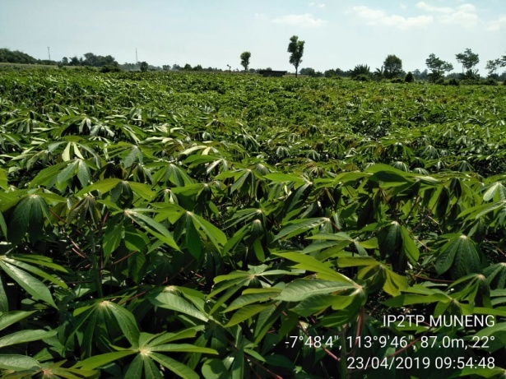
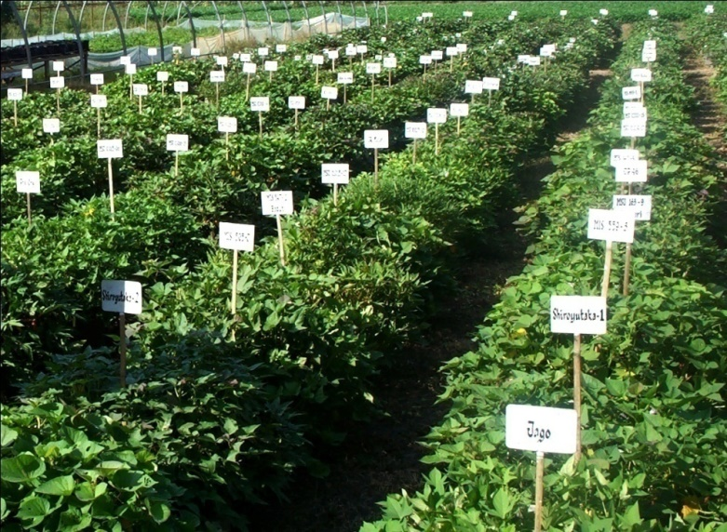
Germplasm collection of cassava and other potential tuber crops in ILETRI Malang
Cassava 325 accession
Sweet potato 331 accession
Taro 82 accession
Xanthosoma 16 accession
Amorphophallus 21 accession
Canna 19 accession
Maranta 12 accession
Dioscorea alata 74 accession
Dioscorea hispida 16 accession
Discorea esculenta 54 accession
Discorea bulbifera 12 accession

Slide 24
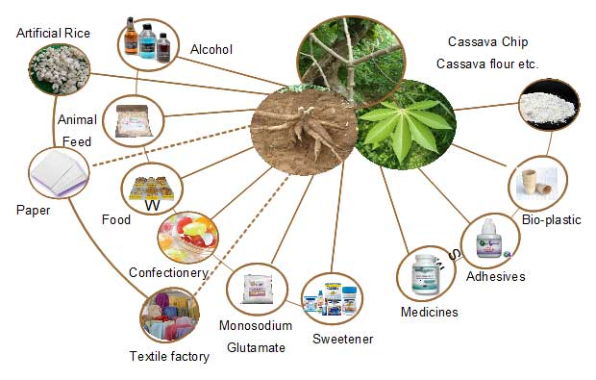
VARIOUS CASSAVA PURPOSES
Reference : Trubus magazine

Slide 25
Various processed products from cassava

Slide 26
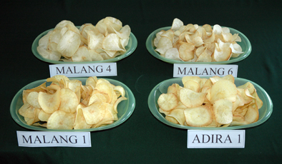
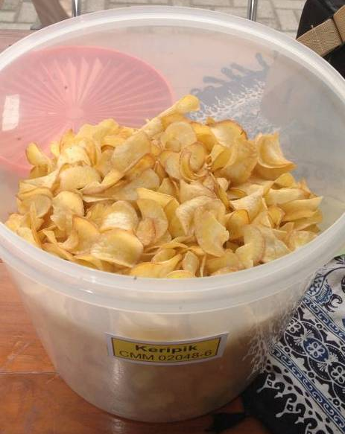
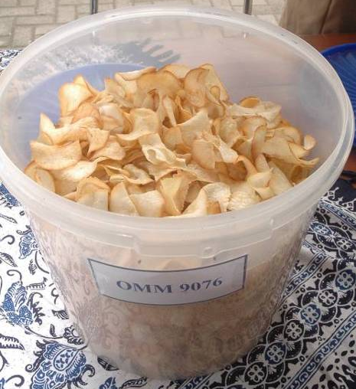
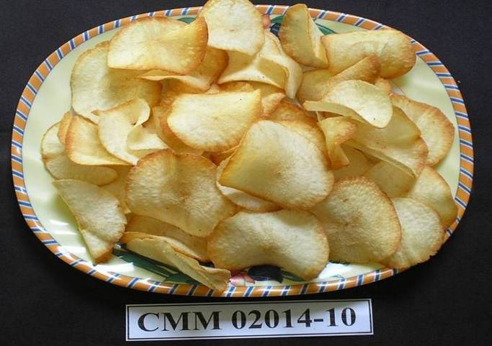

Suitable cassava cultivars for snack chips
Non-bitter types → HCN < 50 ppm
Improved varieties :
Adira 1 and Malang 1
Local variety: Monggu
Promosing clones:
CMM 02014-10
CMM 02048-6
OMM 9076

Slide 27
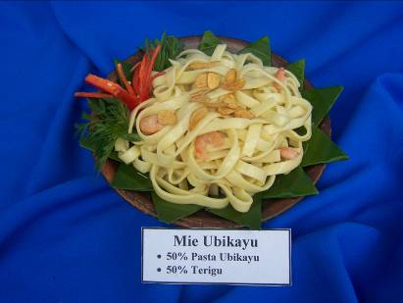
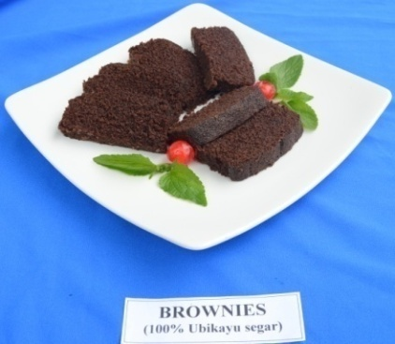
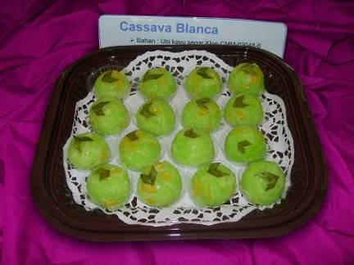

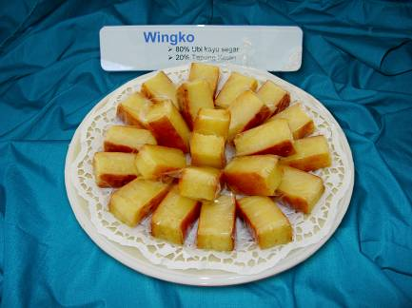
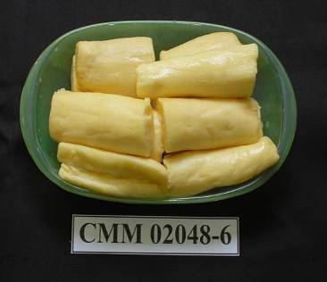
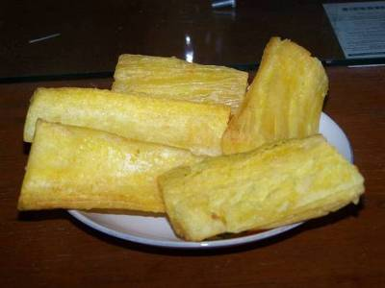
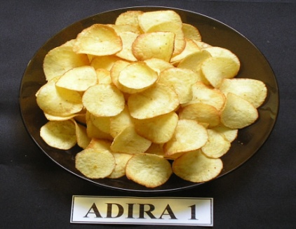
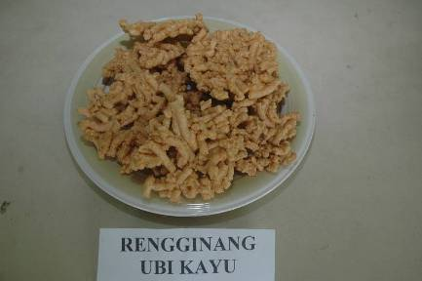
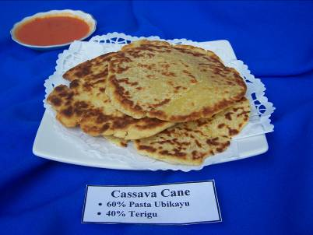
FOOD PRODUCTS OF FRESH CASSAVA
Fresh roots : steamed/fried. fermented. snacks.
chips. crisps. and brownies
Pasta/: 50-100% proportion in snacks, and noodle
mash
Suitable criteria: non-bitter type, crunchy texture,
extended volume when steamed, not fibreous.
Notes:
27
27

Slide 28
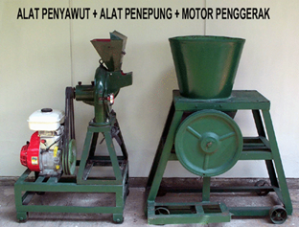
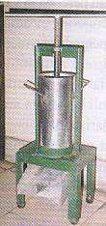
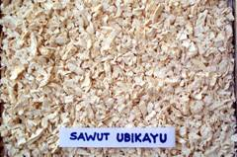
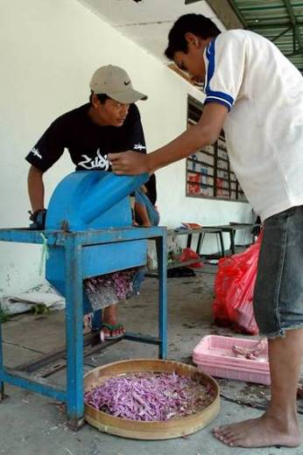

INTERMEDIATE PRODUCTS OF CASSAVA
CASSAVA FLOUR
FRESH ROOTS
- Sorting
- Peeling
- Washing
- Shredding/Chipping
CHIPS
SLICE
- Pressing
- Drying
- Milling
- Sieving 80 mesh
MOCAF = MODIFIED CASSAVA FLOUR → with fermentation
→ physical and chemical characteristics approaching wheat flour
CASSAVA FLOUR (yield recovery 25-30%)

Slide 29

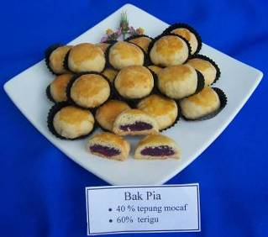
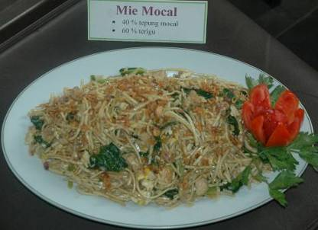
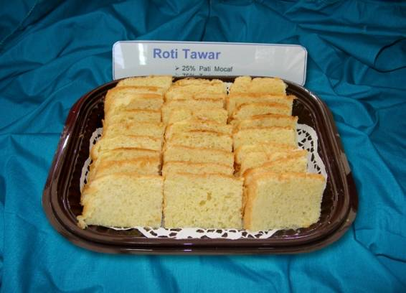
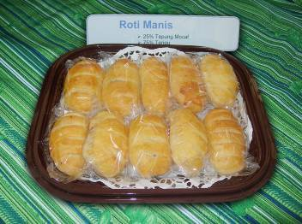

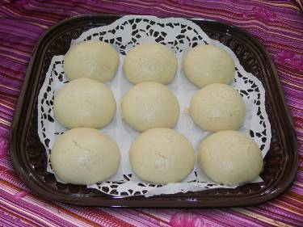
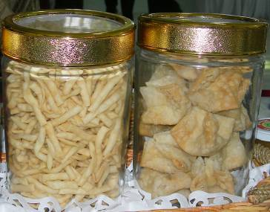
MOCAF-BASED PRODUCTS
As a wheat flour substitute up to 100% for cookies, up to 50% for cakes, 25-30% for bread, 40% for noodle and 40-80% for deep-fried products

Slide 30
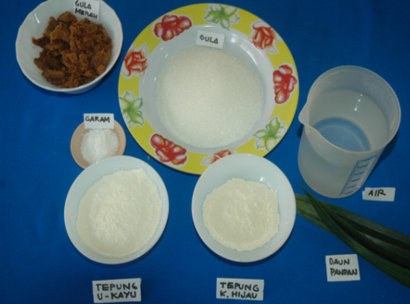
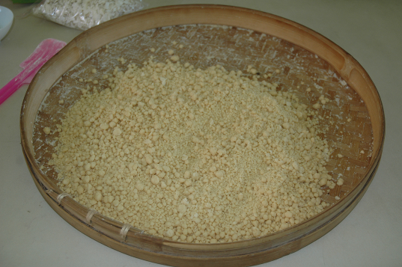
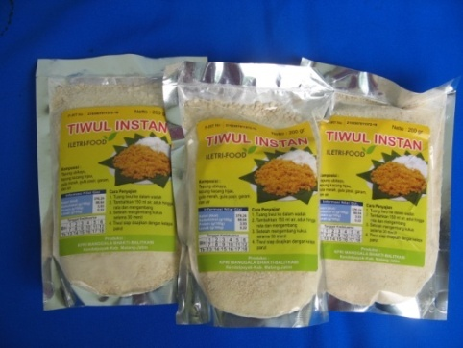
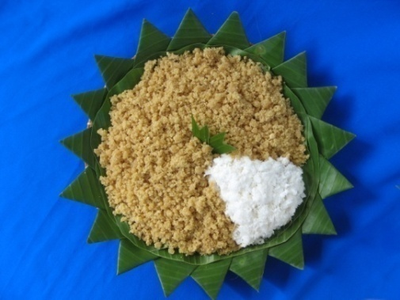
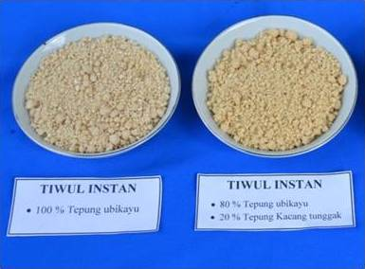
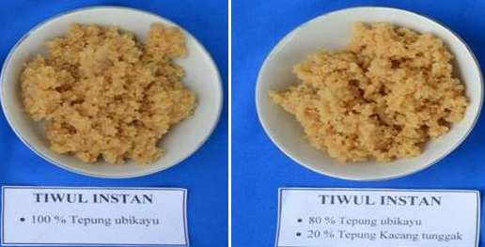
INSTANT TIWUL (composite of cassava and mungbean flours)
The protein content increased from 1.26% to 3.9%
INSTANT TIWUL (composite of cassava and cowpea flours)
The protein content increased from 1.26% menjadi 4.5%
Notes:
30

Slide 31
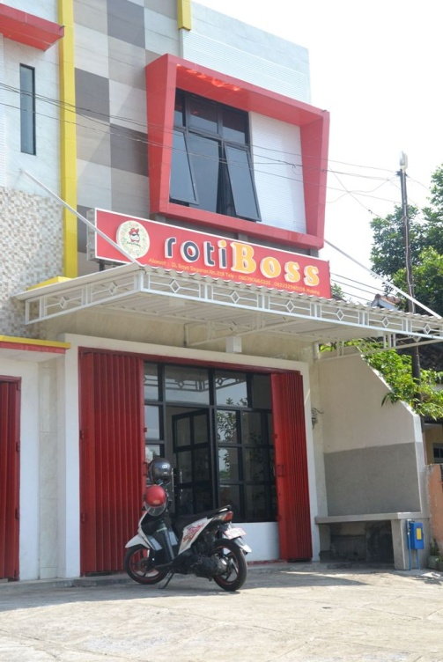
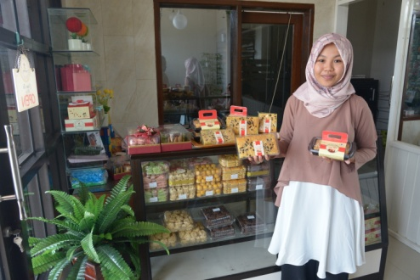
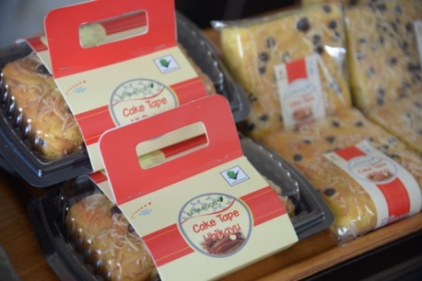
BUSSINESS INCUBATOR COLLABORATED WITH ILETRI
(CAKE TAPE UBIKAYU → USES 50% OF CASSAVA FLOUR)

Slide 32
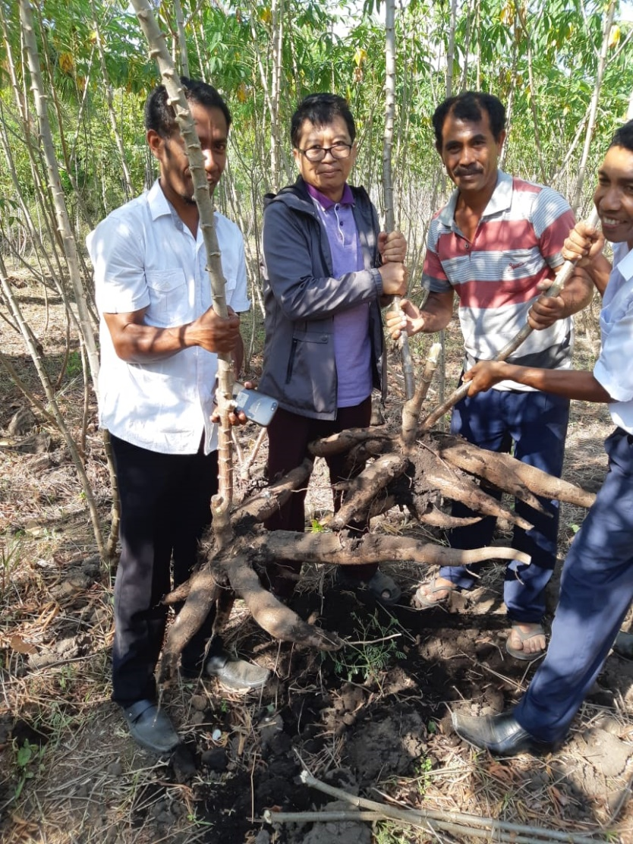
malang 4 variety in
North sumatra (left) and east nusa tenggara (RIgHT)

Slide 33
References
M. Syakir, Andriko Noto Susanto, & Joko Susilo Utomo. 2017. Root & tuber crops development policy in Indonesia for food sustainability.
Iletri. 2016. ILETRI profil.
Ali Jamil. 2018. Policy for cassava developing in Indonesia.
Kartika Noerwijati & Abdullah Taufiq. 2019. Cassava
in Indonesia.

Slide 34

Thank you
Science
Innovation
Networks
IAARD-ICFORD_ILETRI
www.litbang.pertanian.go.id

