Slide 1




AGRONOMY AND ECONOMIC ANALYSIS

Slide 2
Objective 2:
Increase the adoption of improved and sustainable cassava
technologies by strengthening linkages between primary value-chain actors (farmers, traders, processors) and with support actors (researchers, government
agencies).
Conduct participatory evaluation of new varieties, fertility management, pest and disease management, intercropping, and post-harvest practices (such as improved production of dried chips to meet alternative market demands) with farmers and industry stakeholders.

Slide 3
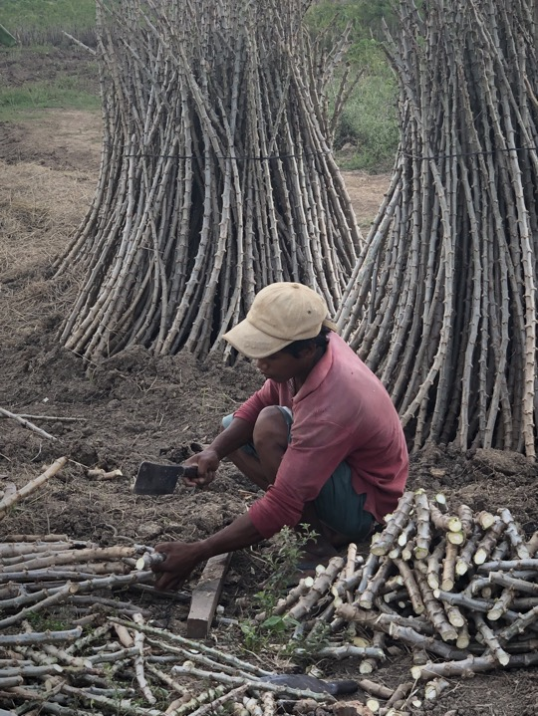
Agronomic experiments
Practices to optimize productivity
  Varietal selection
  Fertilizer application
  Field management
  Effect of biotic and abiotic stress

Slide 4
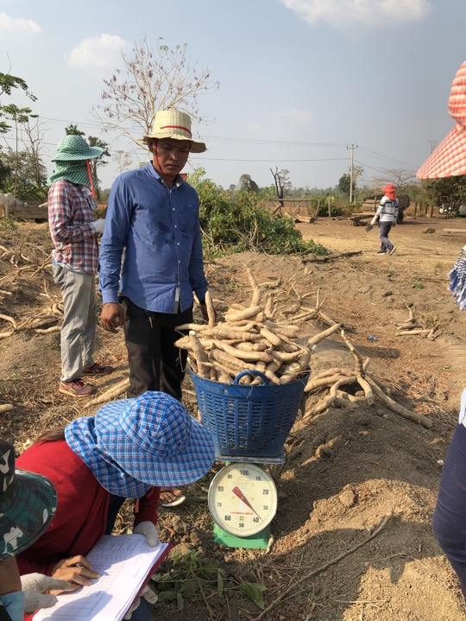
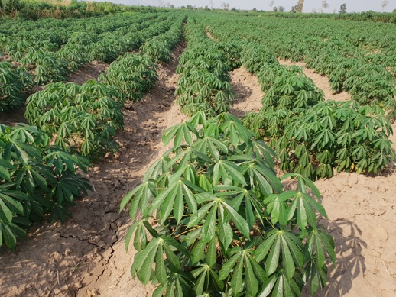
Field days:
Varietal selections: Farmers’ participatory
Yield and starch content
Disease resistance
(became very important)

Slide 5
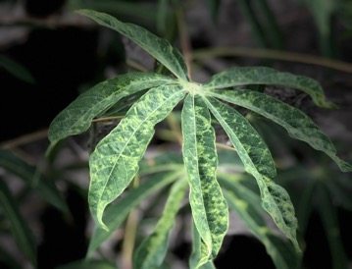
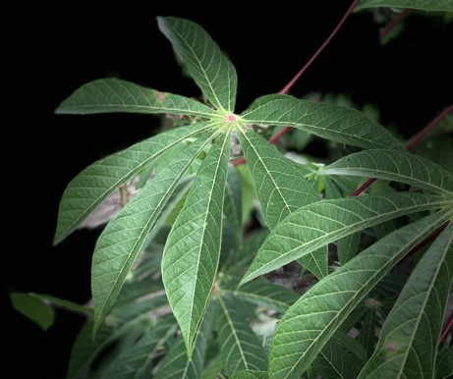
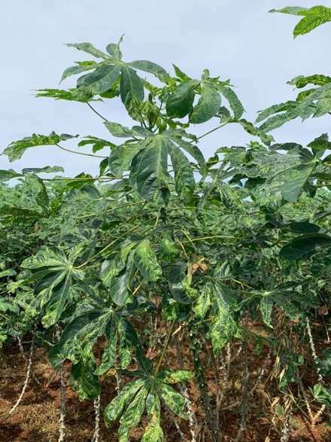
Disease infection

Slide 6
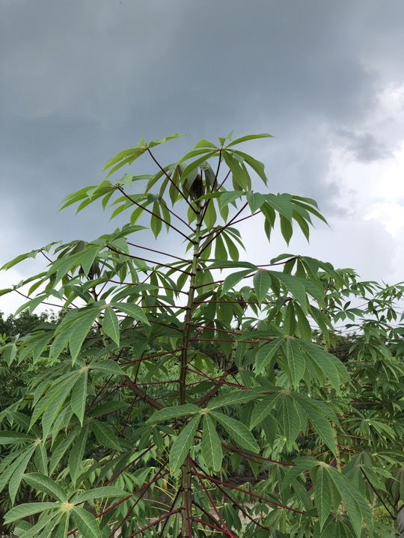
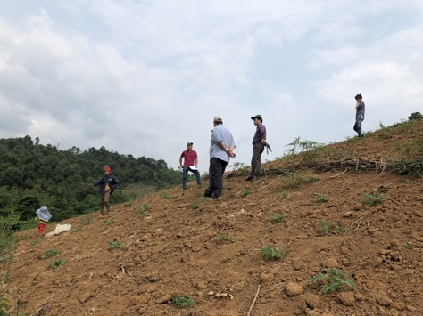
Field management
Fertilizer application: Farmers’ comments and projected benefit (economic analysis)

Slide 7
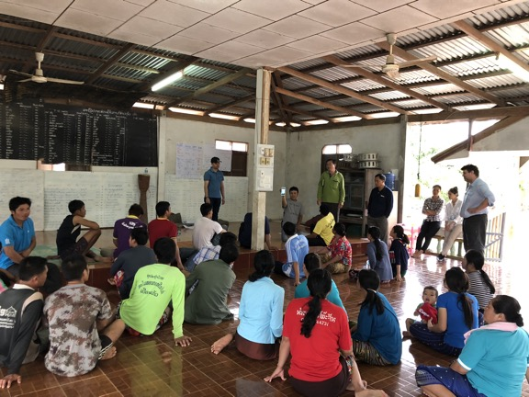
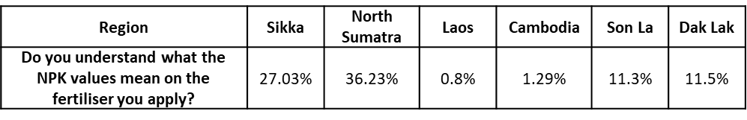
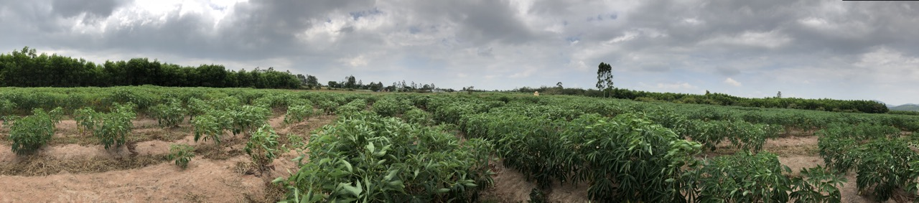
Fertilizer recommendation
Understanding of NPK values, by Region

Slide 8
Why do we need to do all these?
Field level economics
Scaling strategy and Business model
Production risk
Fertilizer recommendation

