Slide 1



ການນຳໃຊ້ຝຸ່ນທີ່ເມາະສົມເພື່ອເພີ່ຜົນຜະລິດແລະ ຮັກສາຄວາມອຸດົມສົມບູນຂອງດິນ
ການເຝຶກອົບຮົມຂອງໂຄງການ ຄົ້ນຄວ້າລະບົບການຜະລິດ ແລະ ການຕະຫຼາດມັນຕົ້ນ, ສຄກປຊ ລະຫວ່າງ 21-22 ເມສາ2016
ພັນທະສິນ ຄັນທະວົງ
Tin Muang Aye

Slide 2
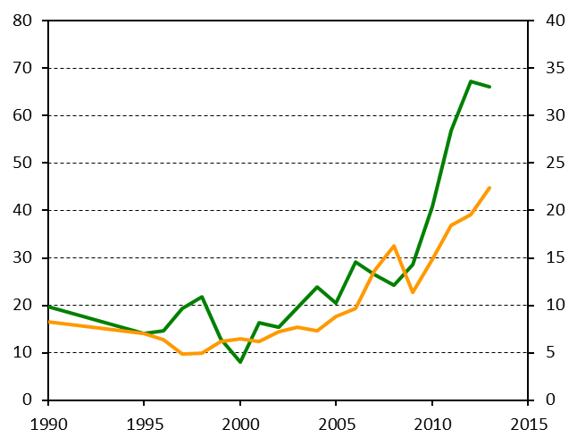
Current cassava production in Laos
Harvest area (1,000 ha)
Tuber yield (t/ha)
Tuber yield in farmer fields varied 12-47 t/ha (survey, NAFRI-JIRCAS, 2013-15).
Yield variation may cause by field management, soil fertility and varieties.

Slide 3
Existing generalizations concerning cassava are either false or half-truths.
Scientific misconceptions:
“Cassava degrades the soils”
and
“cassava does not need to apply fertilizers”

Slide 4
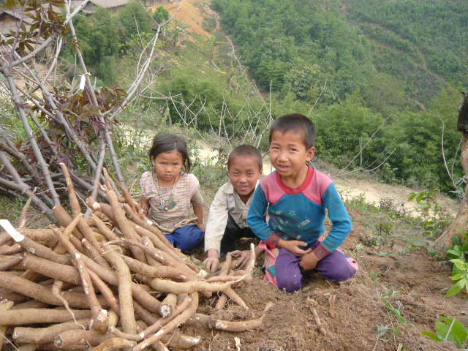
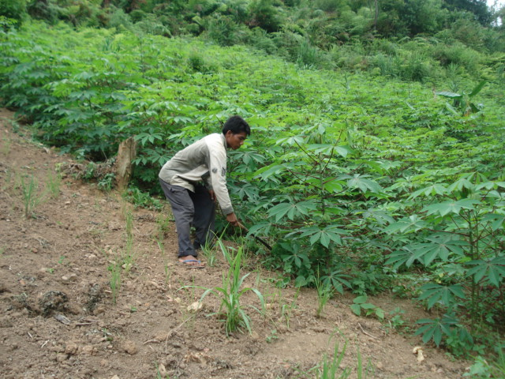
Farmers usually grow cassava on the poorer soils, without irrigation and with limited application of purchased inputs.
It can be found producing moderate yields where many crops simply fail due to the low pH (4-4.5) and high levels of aluminum saturation (80%)

Slide 5
100
80
cassava
60
upland rice
Relative yield (%)
40
20
0
1
2
3
4
Years of continuous cropping
Yield reduction of upland rice and cassava due to fertility decline as a
result of continuous cropping without fertilizer application.
100% corresponds to 18.9 t/ha of fresh cassava roots and 2.55 t/ha of rice.
Source: adapted from Nguyen Tu Siem, 1992.

Slide 6
Approximate classification of soil chemical characteristics according to the nutritional requirements of cassava
Soil parameter¹⁾ | Very low | Low | Medium | Hight | Very high
pH | <3.5 | 3.5-4.5 | 4.5-7 | 7-8 . | >8
Org. matter(%) | <1.0 | 1.0-2.0 | 2.0-4.0 | 4.0-8.0 | >8.0
P (mg/g) | <2 | 2-5 . | 5-20 . | 20-50 | >50
Ca (me/100 g) | <0.25 | 0.25-1.0 | 1.0-5.0 | >5.0
Mg (me/100 g) | <0.2 | 0.2-0.4 | 0.4-1.0 | >1.0
K (me/100 g) | <0.10 | 0.10-0.15 | 0.15-0.25 | >0.25
Al-saturation(%) |  |  | <75 | 75-85 | >85
Na-saturation |  |  | <2 | 2-10.0 | >10
Salinity (mmhos/cm) |  |  | <2 | 2-10.0 | >10
S (mg/g) | <20 | 20-40 | 40-70 | >70
B (mg/g) | <0.2 | 0.2-0.3 | 0.3-1.0 | 1-2 . | >2
Zn (mg/g) | <0.5 | 0.5-1.0 | 1.0-5.0 | 5-50 . | >50
Mn (mg/g) | <5 | 5-10 . | 10-100 | 100-250 | >250
Cu (mg/g) | <0.1 | 0.1-0.2 | 0.2-1.0 | 1-5 . | >5
Fe (mg/g) | <1 | 1-10 . | 10-100 | >100
¹⁾pH in H₂O: OM by method of Walkley and Black:
Al saturation = 100 x Al (Al + Ca + Mg + K) in me/100g;
P in Bray II; K, Ca, Mg and Na in 1N NH₄-acetate; S in Ca-phosphate;
B in hot water; and Cu, Mn, Fe and Zn in 0.05 N HCI + 0.025 N H₂SO₄
Source: modified from Howeler, 1996.

Slide 7
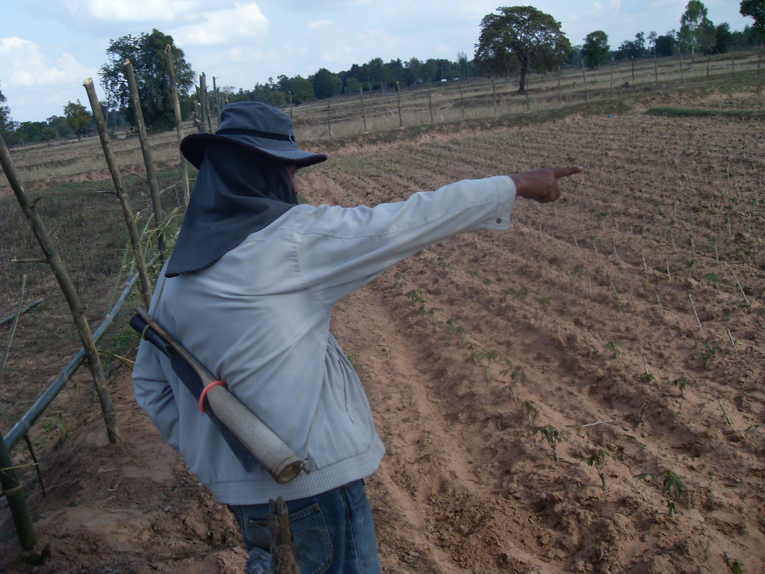
Soil productivity decline mainly due to:
Nutrient depletion
Soil erosion

Slide 8
The crop is highly responsive to nutrient application. High yielding cassava varieties are more responsive to mineral fertilizers than traditional cassava varieties.

Slide 9
Nutrient uptake and removal in cassava
Crop | Yield t ha⁻¹ | Total uptake (above-ground biomass) kg ha⁻¹ |  |  |  |  |  | Removal (crop yield) kg t⁻¹
 |  | N | P | K | Ca | Mg | S | N | P | K | Ca | Mg | S
Cassava | 20 | 95 | 15 | 91 | 50 | 15 | 10 | 1.7 | 0.5 | 2.5 | 0.4 | 0.2 | 0.2
Fertilizer recommendation rate for cassava (kg ha⁻¹)
Targeted root yield: |  |  |  | N |  | P |  | K |  | Mg |  | S
12 t ha⁻¹ |  |  |  | 40 |  | 8.7 |  | 16.6 |  | 3 |  | 5
20 t ha⁻¹ |  |  |  | 200 |  | 34.9 |  | 83 |  | 12 |  | 20

Slide 10
Tuber yield decreased at the 3rd cultivation in the ‘no application’ treatment due to small-sized tubers.

Slide 11
 | Soil condition for 2012/13
 | Soil condition for 2013/14
 | Soil condition for 2014/15
Enhancement of K, Mg, and Ca is recommended.
Other properties are not at limiting levels;
pH (4.8-4.9), T-C (8.5-9.4 g/kg),
T-N (0.88-0.92 g/kg), ava-P (18-22 mg/kg)

Slide 12
Optimum fertilizer application for cassava production in various locations, soils, and systems in Asia
Location/Soil/System | N: P₂O₅: K₂O (kg/ha)
Nanning, Guangxi, China | 100:50:100
Danzhou, Hainan, China | 200:100:200
Thiruvananthapuram, Kerala, India | 100: 50:100
Tamanbogo, Lampung, Indonesia / cassava mono crop | 90:25:90
Tamanbogo, Lampung, Indonesia / intercropped cassava | 90:50:90
Baybay, Leyte, Philippine | 60:90: 60
Ubay, Bohol, Philippine | 120:60:120
La Granja, Negros Occidental, Philippine | 100: 50:50
Hung Loc Center, Dong Nai, Vietnam | 80:40:80
Serdang, Malaysia / mineral soils | 60: 30:160
Thailand / most cassava soils | 100: 50:100

Slide 13
ຂອບໃຈ

