Slide 1
Evaluation of technical issues and commercial constraints in Philippine mango exports to China ECR study – Mango Biosecurity Project Ivory Myka Galang Philippine Institute for Development Studies 19 – 21 March 2019

Slide 2
Overview
Introduction
Market overview
Methodology
Results
Conclusion
References

Slide 3
Introduction
This case study aims to identify technical, scientific and commercial constraints that may be impeding the Philippines from meeting mango export market requirements to China.

Slide 4
Market overview
Philippine mango
Variety: Carabao
8 VHT facilities (5 Luzon, 3 Davao)

Slide 5
Methodology
Interviews
Three (3) fresh mango exporters (all with VHT)
Davao, Cebu/Manila
Bureau of Plant Industry (an attached agency of Philippine’s Department of Agriculture)

Slide 6
Results
Industry feedback
Procurement of export-grade mango
Cost of inspection (foreign quarantine officer/s)
MRL (too strict)
VHT (costly; refrigeration affects taste)
Small market in China

Slide 7
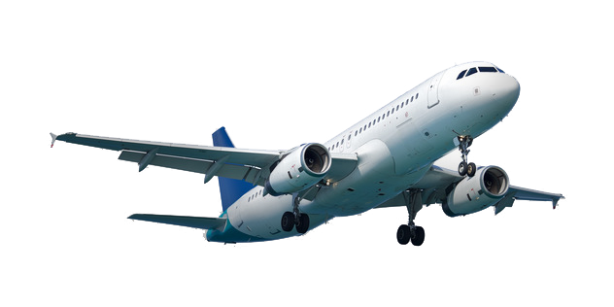
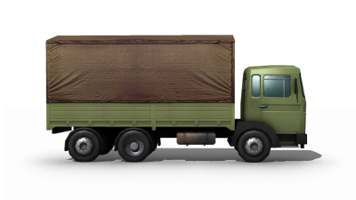
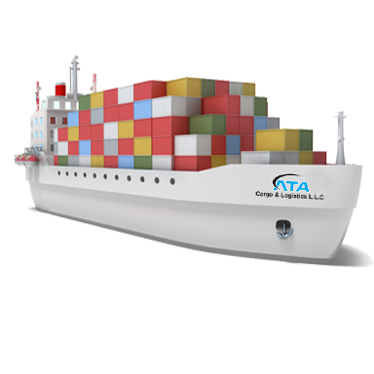
Results
Procurement issue
Cost of inspection
Production practices
VHT-related
Small market, competitiveness
MRL (Ph)

Slide 8
Recommendations
Procurement of export-grade quality mango:
More direct transactions between producers and exporters to encourage mango growers to plant good-quality/better export-quality mangoes.
Cost of foreign inspectors:
Negotiation with importing countries to discuss possibility of local quarantine officers conducting physical inspections.
Problems related to mango treatments:
Research/collaborations to make VHT more cost-efficient.
Explore other possible treatments, such as the extended hot water treatment, which has been approved by China.

Slide 9
Recommendations
Exporters should buy directly from growers
Deputise local inspectors
Collaborate with other researchers; explore other treatment options
Small market, competitiveness

Slide 10
References
Bureau of Plant Industry. (2018). Exports. Retrieved from URL:http://pqs.bpinsicpvpo.com.ph/export.php.
___. (2002). Commodity Profile of Mango in Region I. URL: afmis.da.gov.ph/index.php/component/.../907-commodityprofileofmangoregioni.html.
Philippine Statistics Authority (PSA). (2018). Volume of production: Mango. Retrieved from URL: http://countrystat.psa.gov.ph/

Slide 11
Image references
https://dumielauxepices.net/sites/default/files/small-clipart-mango-tree-766451-5528785.png
http://www.transparentpng.com/cats/cargo-truck-137.html
https://www.kisspng.com/png-facade-factory-icon-green-cartoon-factory-and-ware-331348/preview.html
https://cdljobnow.com/specialty-jobs/refrigerated-trucks
http://alldubai.ae/yellow-pages/sea-freight-service-by-ata-cargo-logistics-llc/
http://www.pngall.com/plane-png/download/5535
https://www.countryflags.com/en/japan-flag-icon.html
https://wonderfulengineering.com/flag-of-china-a-symbol-of-revolution-and-unity/
http://flagpedia.net/south-korea
https://www.countryflags.com/en/philippines-the-flag-image.html

